Slide 1

Shut Out: Exploring the Impact of Institutional Investors on Middle Neighborhoods
Sponsored by the Middle Neighborhoods Community of Practice
Moderator: Marcia Nedland

Slide 2


Middle Neighborhoods Initiative
A National Initiative focused on mobilizing attention to reverse the disappearance of middle neighborhoods through decline or gentrification. The initiative does this through
  A Community of Practice that facilitates peer-to-peer learning among middle neighborhood practitioners. The CoP connects more than 800 practitioners, policymakers and researchers to each other through webinars, events, case studies, newsletters, and virtual site visits.
  Research into topics relevant to middle neighborhood practitioners and policymakers.
  Policy analysis and advocacy around housing, lending and other community development issues.
  Communications strategies to advance awareness and technical knowledge among a wide variety of audiences.
The initiative is coordinated by the National Community Stabilization Trust and NeighborWorks America and is advised by a Steering Committee of 20 prominent researchers, practitioners, and policy makers.

Slide 3
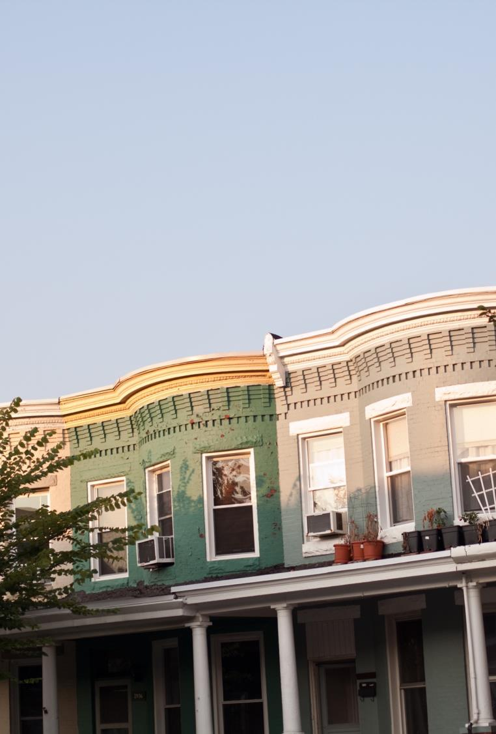
Characteristics of Middle Neighborhoods
Mostly single-family housing, built for families with children.
Still well more than 50% owner-occupied, but slowly eroding.
Housing stock is aging, still in generally acceptable condition, but lacks features and updates to compete well for today’s homebuyers.
Property values range from slow decline to flat to underperforming against city and/or inflation.
Most of our members do not see hyper-inflation of housing price as a risk in their middles. Only a few middle neighborhoods, those in prime locations and usually mostly white, are appreciating, even gentrifying.
More racially and ethnically diverse, a holder of hard-won middle household wealth.

Slide 4
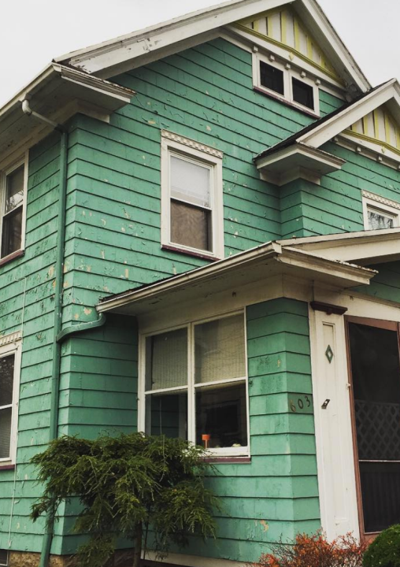
Middle Neighborhoods Are Faltering In Their Sustainability
Ability to reliably attract replacement owner occupants and other neighborhood-friendly buyers.
Ability to generate home values that support quality maintenance, repairs and updates without appraisal gaps.
Ability to repel irresponsible investors.
Ability to maintain engaged residents taking stewardship of the neighborhood.
Ability to deliver home equity to owners and revenue to municipal government.

Slide 5
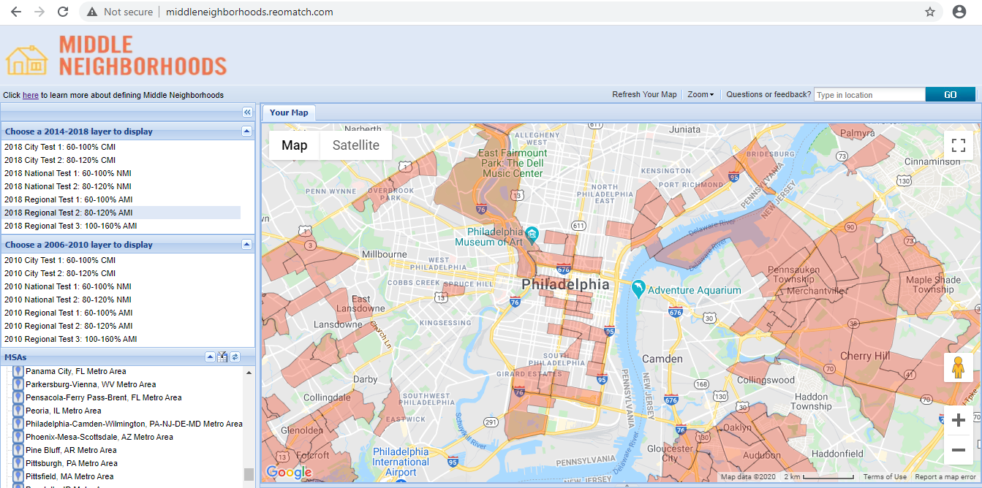
http://middleneighborhoods.reomatch.com/
Displaying census tracts with median household incomes between 80 and 120 percent of regional/MSA median ($69,465), or $55,572 - $83,358

Slide 6
Guests
Sally Martin
  Housing Director
  City of South Euclid
Timothy Kobie, PhD
  Business Process Analysist
  City of Cleveland
Jayme Lucas-Bauer
  Neighborhood Development Project Manager
  Old Brooklyn CDC

Slide 7
Agenda
Intro to Middle Neighborhoods
  Marcia Nedland
City Perspective
  Sally Martin
MSA Perspective
  Timothy Kobie, PhD
Neighborhood Perspective
  Jayme Lucas-Bauer
Strategies and Policy
  Sally Martin
Q & A

Slide 8


Slide 9
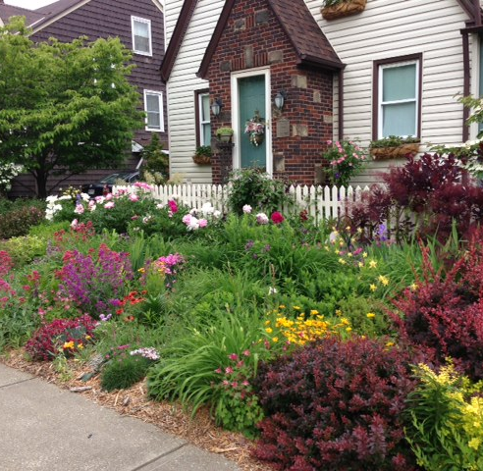
South Euclid Overview
Inner Ring Cleveland Suburb
Population of 21,572 (2019)
Racially Diverse:
  46.8% White; 45.32% African American
Median Home Price:
  $120,000 – 2020
  $95,000 – 2019
  $87,000 – 2018

Slide 10
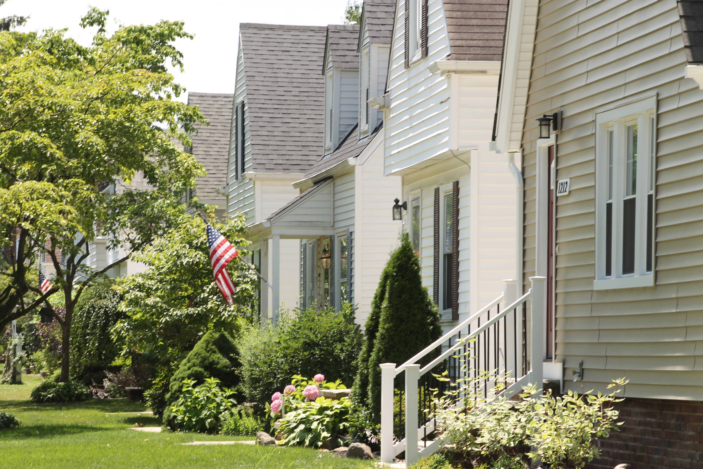

Slide 11
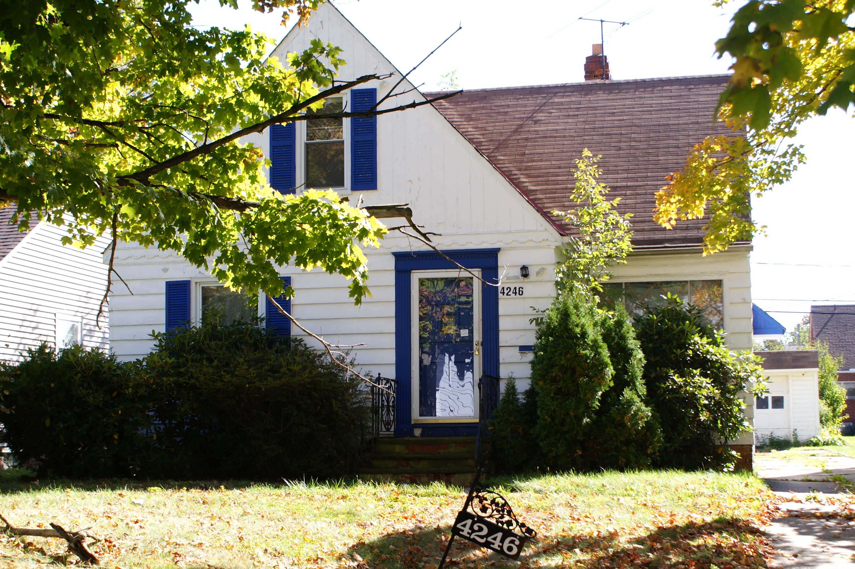

Slide 12
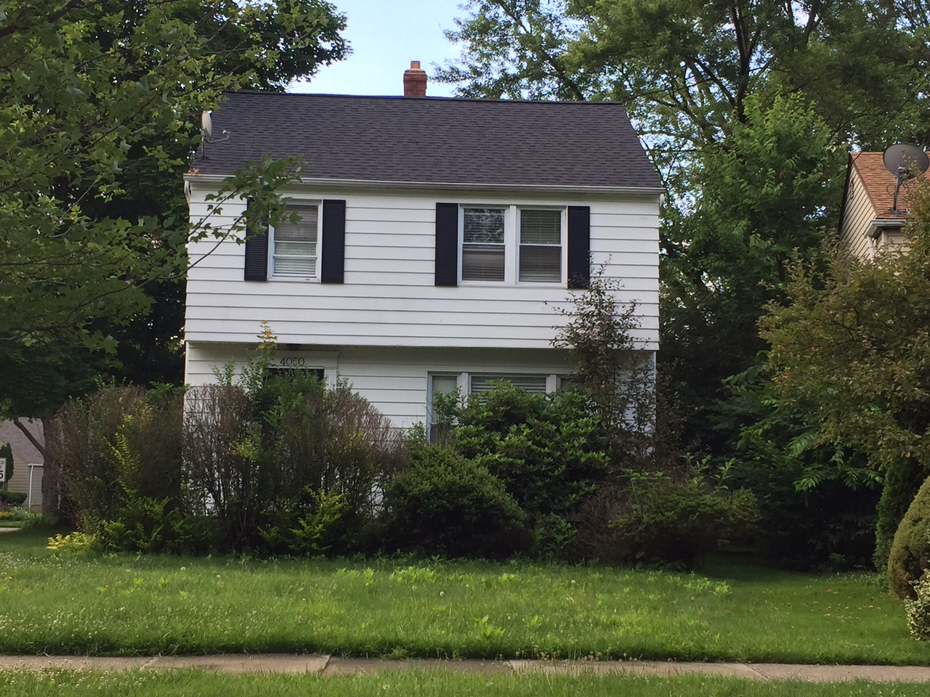
VAPAC Investor Working Group
Established in 2017 to share information and best practices
Created a data base of investor information and property holdings
Goal=Coordinate action to curb irresponsible investor behavior in region—not just within municipal boundaries

Slide 13
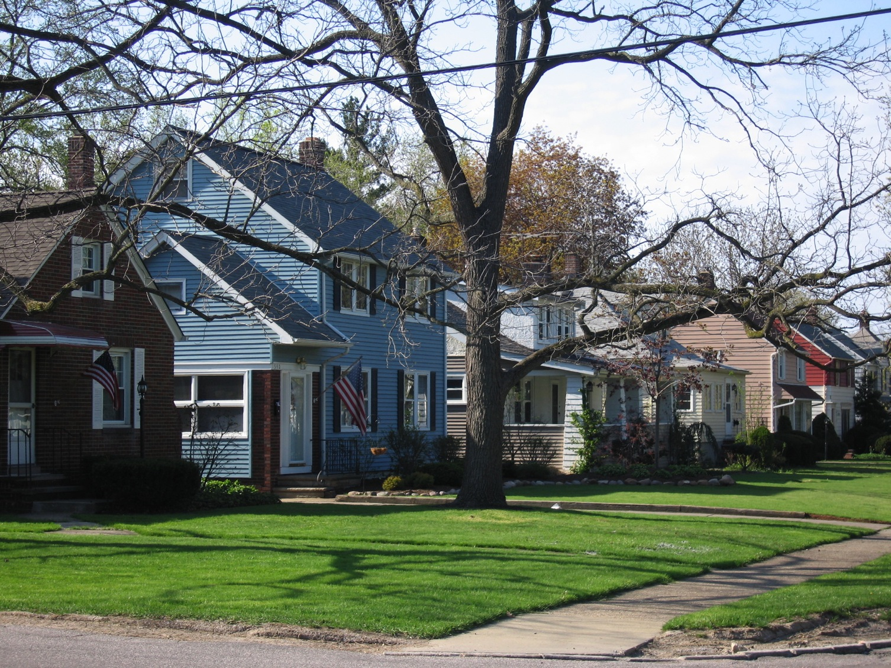
Code Enforcement Strategies
Rental Ordinance: Annual Registration of all rental properties; inspection every three years inside and out; no registration of properties with delinquent property taxes; must have local agent-in-charge if out of town ownership; cross check records of school district to find unregistered rentals; MOU with Housing Authority; fines and penalty fees for non-compliance.
Owner Occupied homes are inspected, exterior only every six years
Aggressive follow up of complaints and for quality of life issues like trash cans left at the curb and high grass and weeds
Demolition and Orders of Nuisance Abatement used as needed
Monitor property transfers to look for activity and non-compliance: Realtor.com and Redfin are goldmines of information!

Slide 14
Vacant Building
Registration Ordinance
Combines traditional registration requirement
with a point-of-sale inspection
  Properties are inspected – full interior and exterior
  Buyers are requires to assume violations and escrow 100% of the estimated costs of the repairs
  Daily fines of up to $1,000 imposed as a lien on the property
  Criminal misdemeanor charges

Slide 15
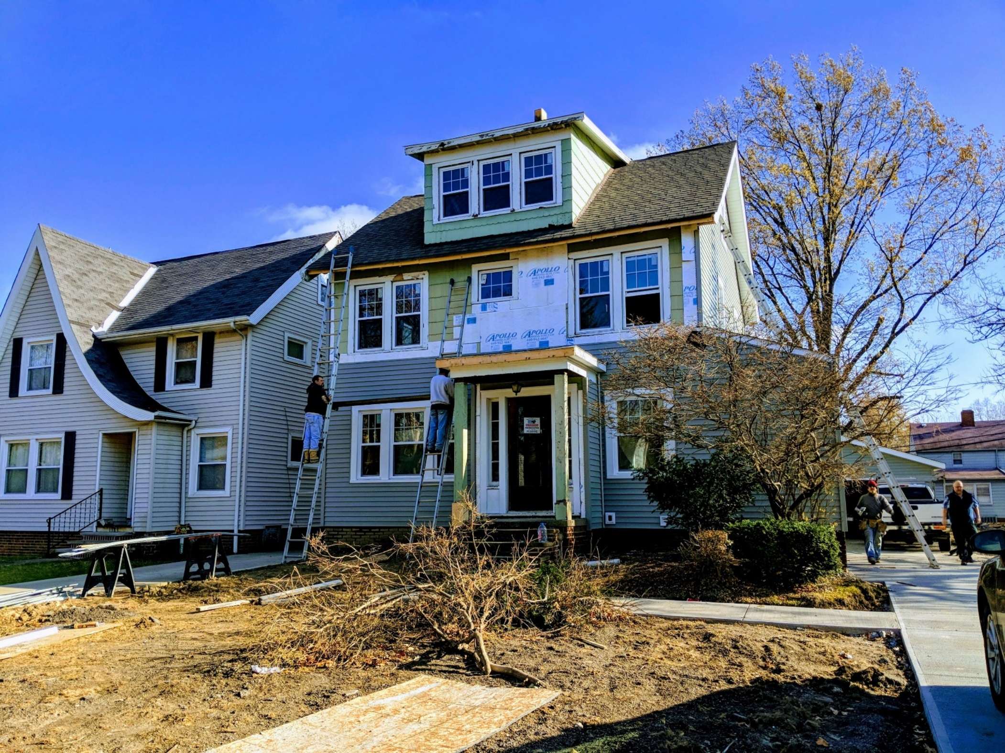

Slide 16
Vacant Building
Registration Ordinance
Since the ordinance was passed in 2010
Over 1,200 vacant homes have been made fully code compliant
Over $200 million in residential and Commercial Investment in South Euclid

Slide 17
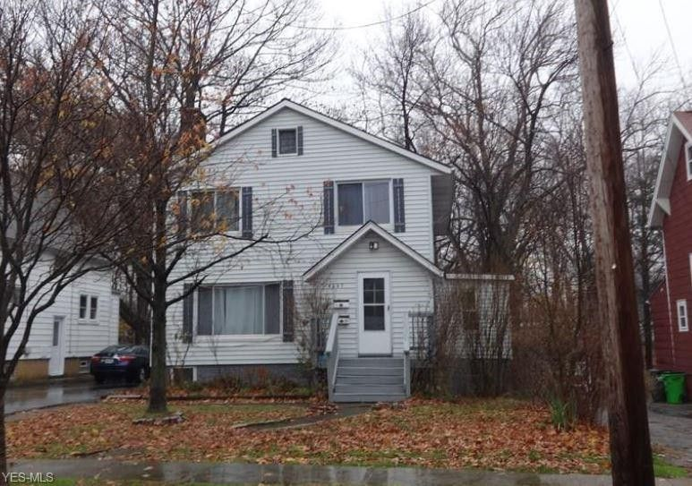
Enforcement Strategy: Holton Wise Example
4661 Liberty Rd
South Euclid Ordinances Used in Enforcement (summaries):
1411.04(d): Out of county property owners are required to have a local agent/manager
1411.05: Appropriate legal action for non-compliance with notices may be taken against owner/agent/manager
Bought by California Investor through HW 2017
2018 HW submitted rental registration late and with incorrect payment
No response to notices to correct payment for registration
3/19/18 charges filed against John Holton, owner of HW
8/6/18 Found guilty in bench trial, fees paid
No new HW properties, no compliance issues since court

Slide 18

Decreasing Number of Rentals
  ~9600 Residential Parcels in City
  1721 Total Rentals 2021
  98 Rentals became owner occ 2020
  (89 in 2019; 99 in 2018)

Slide 19
Recommendations
Strong code enforcement is critical!
Coordination with law department is essential!
Regional information sharing is powerful!

Slide 20
Key Recommendations of the VAPAC Investor Working Group
Hold every person or entity with a responsibility to maintain property accountable
Require local agent-in-charge for non-local property owners
Transfer existing property maintenance violations to new owners
Make better use of the ability to use both criminal and civil proceedings for code compliance
Expand right to counsel, enact pay to stay and source of income protection legislation
Enhance enforcement of rental registration ordinances
Require an interior and exterior inspection including assessing lead hazards every three years
Make repair capital accessible to mom-and-pop landlords through a loan-loss reserve fund and provide significant grant funding for lead remediation
Ensure that adequate funding is available to demolish vacant parcels that cannot reasonably be rehabilitated
Create a targeted down payment assistance program to spur homeownership in areas with high rates of business ownership

Slide 21






“Never doubt that a small group of thoughtful, committed people can change the world. Indeed, it is the only thing that ever has.”
-Margaret Mead
smartin@seuclid.com
216.691.4219
www.cityofsoutheuclid.com
www.onesoutheuclid.com

Slide 22
The Rise of Businesses as Buyers in the 1-3 Family Residential Property Market
Cuyahoga County 2004 - 2020
Timothy F. Kobie, PhD
City of Cleveland
Department of Building and Housing
Middle Neighborhoods Presentation
November 16, 2021

Slide 23
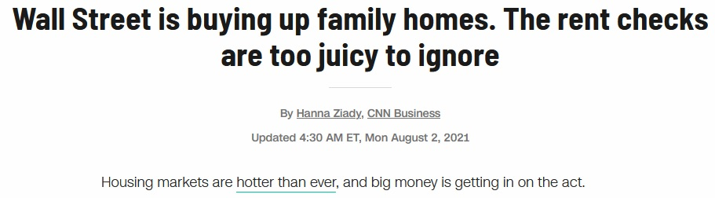
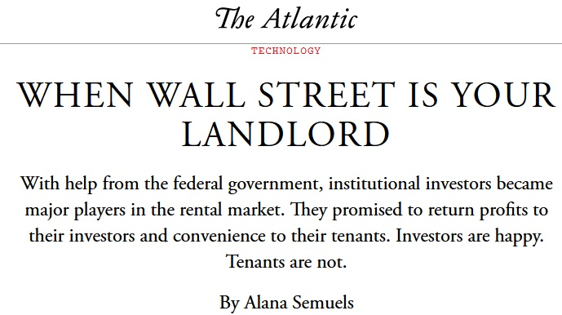
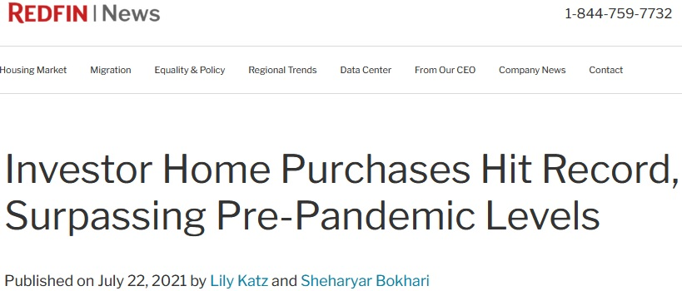


Slide 24
Building a dataset
NEOCANDO has sales data going back to 1976 for Cuyahoga County
Go back to 2004 to see what types of buyers there were before foreclosure crisis and up through 2020
Limit it to 1-3 family structures
Code buyers into one of 7 categories
  Bank; Business; Federal Gov./GSE; State Forfeiture; Individual; Land Bank/Local Gov.; Trust/Trustee
Focusing on differences between business and individual buyers for this presentation
Those two groups accounted for approximately 90% of all buyers in 2020

Slide 25
Baseline – 2004
 | % Business Buyers 2004 | 2000 Census Percent Black
East Side CLE | 15.94% | 78%
West Side CLE | 6.57% | 12%
East Inner Suburbs | 6.67% | 42%
West Inner Suburbs | 2.98% | 1%
Outer Suburbs | 3.45% | 6%
Cuyahoga County | 7.17% | 27%
Business buyers on the east side of Cleveland are already a substantially higher percentage than other parts of the county pre foreclosure crisis
Dropping 2 and 3 family structures yields 16.8% business buyers on the east side of Cleveland, so numbers do not appear to be driven by higher amount of 2 and 3 family homes on east side of Cleveland
Less than 70% of buyers were individuals on east side of Cleveland in 2004
West side of Cleveland and east inner suburbs had 85% individual buyers
Other submarkets even higher for percentage of individual buyers
Important to remember individual buyer does not necessarily mean homeowner; individuals could be investors but dataset cannot tell us that

Slide 26
Most Recently - 2020
 | % Business Buyers 2020 | ACS 2018 5 Year Estimate Percent Black
East Side CLE | 45.76% | 78%
West Side CLE | 25.61% | 22%
East Inner Suburbs | 28.45% | 57%
West Inner Suburbs | 8.91% | 6%
Outer Suburbs | 7.11% | 11%
Cuyahoga County | 21.10% | 31%
Increases in percentage of business buyers across all submarkets
Biggest increases on east side of Cleveland and east inner ring: 30 & 22 percentage points
West side of Cleveland increased 19 percentage points
Investor buyers account for over 1/3 of all buyers on east side of Cleveland and east inner suburbs, limiting home ownership opportunities in those markets
More business buyers on east side of Cleveland than individual buyers in 2020
Impacts neighborhood stability and ability to build wealth

Slide 27
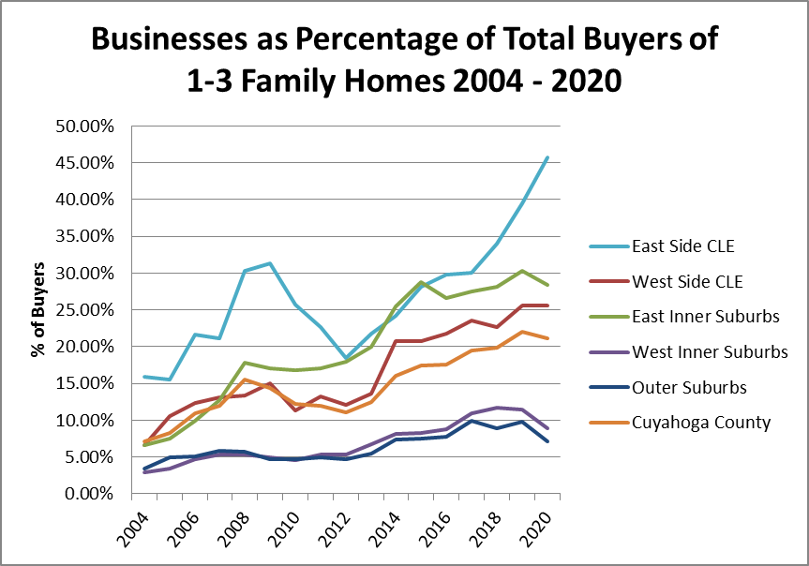
The Years in Between
Outer suburbs and west inner suburbs relatively flat until 2012 and then steady increase from around 5% to 10% business buyers
Other markets saw increase during foreclosure crisis then a decrease or leveling off of business buyers until 2012
Those same markets have seen strong growth in the percentage of business buyers since 2012
As economy recovered, real estate has been an attractive investment, especially in less robust markets like Cuyahoga County
Every submarket was either flat or declined in 2020 with respect to business buyers with the exception of the east side of Cleveland

Slide 28
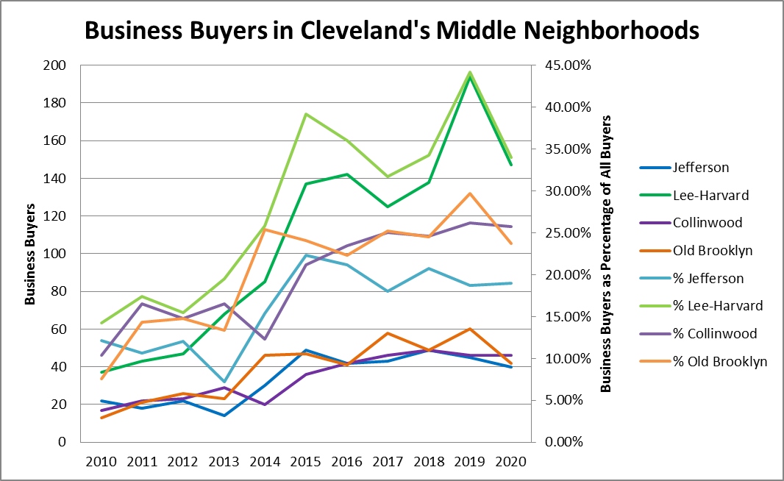
What are we seeing in Cleveland’s Middle Neighborhoods
Looking at percentage of business buyers for middle neighborhoods compared to east or west side as a whole
Jefferson and Old Brooklyn were slightly above or slightly below the west side as a whole in 2010
Lee-Harvard and Collinwood were substantially below east side as a whole in 2010
2015 sees both west side middle neighborhoods slightly above west side as a whole
We see split for east side middle neighborhoods. Lee-Harvard is about 10% higher and Collinwood is 7% lower than east side as a whole in 2015
By 2020, Jefferson and Old Brooklyn are below west side as a whole as are Lee-Harvard and Collinwood compared to east side
Jefferson saw lowest percentage increase from 2010 to 2020, a little under 7%; Lee-Harvard had greatest increase of nearly 20%; Both Old Brooklyn and Collinwood had increases of around 15%

Slide 29
What price point are businesses buying at? How about individuals?
Median Purchase Price Non Zero Single Property Transactions 1-3 Family Structures
 | 2004 |  | 2012 |  | 2020 |  | 2018
 | Business | Individual | Business | Individual | Business | Individual | ACS 5 YR Est % Black
East Side CLE | $ 29,525 | $ 80,000 | $ 12,450 | $ 15,000 | $ 30,000 | $ 40,000 | 78%
West Side CLE | $ 40,000 | $ 88,000 | $ 21,000 | $ 40,000 | $ 50,000 | $ 95,000 | 22%
East Inner Suburbs | $ 65,000 | $ 113,000 | $ 25,000 | $ 65,500 | $ 55,000 | $ 107,000 | 57%
West Inner Suburbs | $ 109,250 | $ 133,500 | $ 50,000 | $ 103,000 | $ 122,500 | $ 155,000 | 6%
Outer Suburbs | $ 147,500 | $ 177,000 | $ 75,000 | $ 151,000 | $ 120,302 | $ 185,000 | 11%
Cuyahoga County | $ 42,000 | $ 121,053 | $ 27,000 | $ 100,000 | $ 48,300 | $ 135,000 | 31%
Difference between business and individual median purchase prices at the county level indicates that businesses tend to purchase mostly at the lower end of the market; Also businesses tend to buy in CLE and east inner suburbs
Not inherently a problem if businesses are buying properties, pulling permits, doing necessary rehab work, and then in turn renting out a well maintained unit or selling to a future homeowner
Businesses buying at large discounts still in 2012, except east side of CLE where business and individual are both low
Gap between the two buyer types on east side of Cleveland remains negligible in 2020; Are these individuals owner occupants or investors themselves?
The two submarkets that have not yet recovered to 2004 values for individual buyers are both majority Black

Slide 30
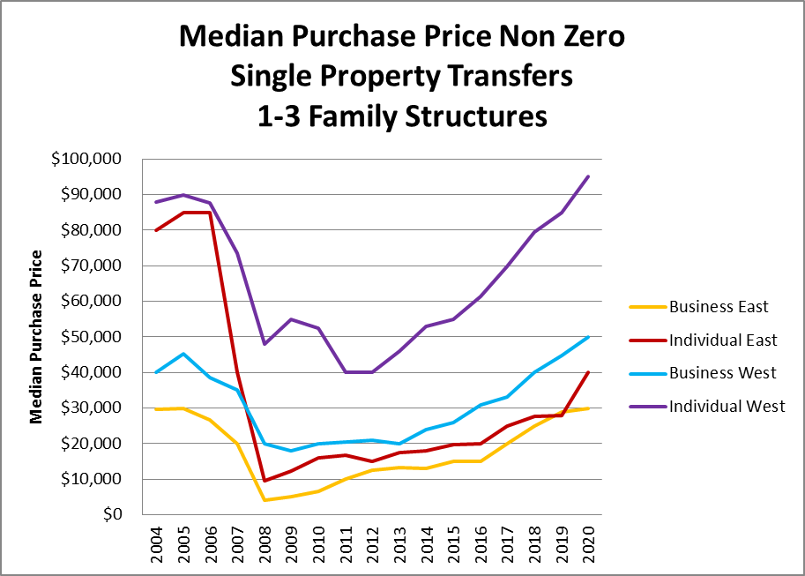
Tracking median purchases prices in Cleveland: East and West
Pre-foreclosure crisis individuals were purchasing houses on the east and west side for about the same median price
Businesses were buying for substantially less
East side prices bottomed out in 2008
West side bottomed out in 2011 and 2012 for individual buyers
In 2020, the west side housing market has recovered its value to surpass pre-crisis levels.
East side prices simply have not recovered for individuals. Businesses and individuals are both buying close to the same price.
At between $30,000 - $40,000 median price, is the east side predominately a cash market now?
What opportunities are there for home ownership?

Slide 31
Median Sales Price in Cleveland’s Middle Neighborhoods
 | Median Sales Price Non-Zero Single Property Transfers 1-3 Family Homes
 | Jefferson |  | Old Brooklyn |  | Collinwood |  | Lee-Harvard
 | Business | Individual | Business | Individual | Business | Individual | Business | Individual
2010 | $ 21,025 | $ 39,875 | $ 24,000 | $ 42,500 | $ 21,750 | $ 54,000 | $ 17,000 | $ 55,400
2015 | $ 22,667 | $ 56,697 | $ 23,000 | $ 36,000 | $ 22,000 | $ 62,500 | $ 18,007 | $ 27,500
2020 | $ 60,714 | $ 99,000 | $ 45,000 | $ 89,000 | $ 47,500 | $ 90,000 | $ 40,550 | $ 81,000
West side middle neighborhoods (Jefferson & Old Brooklyn) generally matched west side as a whole in 2010
  Individual buyers were buying at slightly lower median values
East side middle neighborhoods (Collinwood & Lee-Harvard) had higher median values in 2010
By 2015, Jefferson started to recover value for individual buyers, but Old Brooklyn remained depressed
Similarly on east side, Collinwood started to recover value for individual buyers, but Lee-Harvard actually lost value for individual buyers in 2015
In 2020, west side middle neighborhoods were once again mirroring overall west side median values
East side middle neighborhoods were doing much better than east side as a whole in 2020

Slide 32
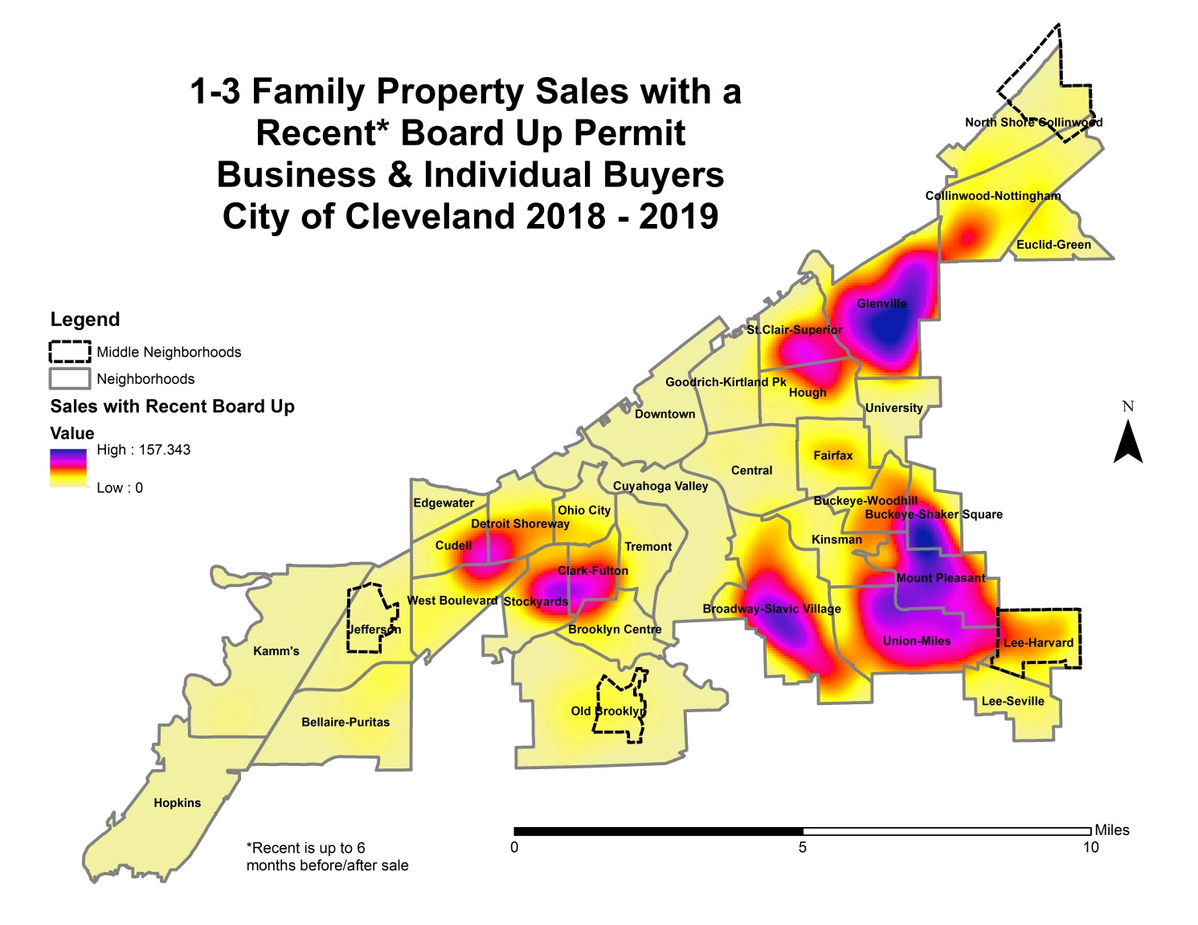
Where are most of these distressed sales occurring?
Not surprisingly, this map looks like many maps of Cleveland
The greatest density of distressed sales (recent board up) occurs on the east side with a few pockets of density on the near west side
Broadway-Slavic Village, Union-Miles, Mount Pleasant, Glenville, St. Clair-Superior, and the southern part of Buckeye-Shaker Square have the highest density of distressed sales by this metric
On the near west side, distressed sales occur most often in Clark Fulton and Stockyards, and parts of Detroit Shoreway, Cudell, and West Boulevard

Slide 33
Buying distressed property isn’t inherently problematic, but rehab work needs to be done according to building codes
1-3 Family Purchases 2018 & 2019 with City of Cleveland Permit Data
Buyer | % of Purchases with any Construction Permit within 6 Months of Transaction Date | % of Purchases with Building Permit within 6 Months of Transaction Date
Business East | 9.37% | 4.14%
Individual East | 9.49% | 4.01%
Business West | 12.17% | 7.97%
Individual West | 9.12% | 5.82%
Given the differences in property quality seen in previous slides, it might be expected that permits after purchase would be higher on the east side, but businesses on west side have highest rate of permits pulled
It is also concerning that individuals on the west side are pulling permits equal to east side businesses and individuals; individuals on west side were purchasing mostly A’s and B’s
Looking only at building permits and excluding mechanicals shows an even greater disparity in investment
West businesses pull permits almost 8% of the time after a purchase and east side businesses and individuals are in the low 4% range
Even individuals on the west side pull building permits at a higher rate than either east side group; 5.82% vs low 4%
Of the 491 purchases in 2018 & 2019 with a recent board up, only 155 had a permit pulled after purchase, down to 99 when only looking a building permits

Slide 34
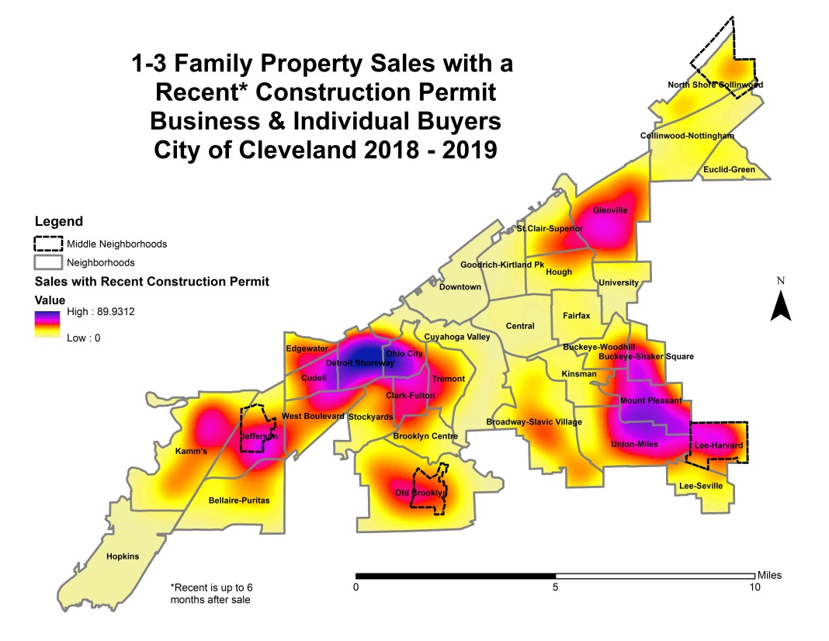
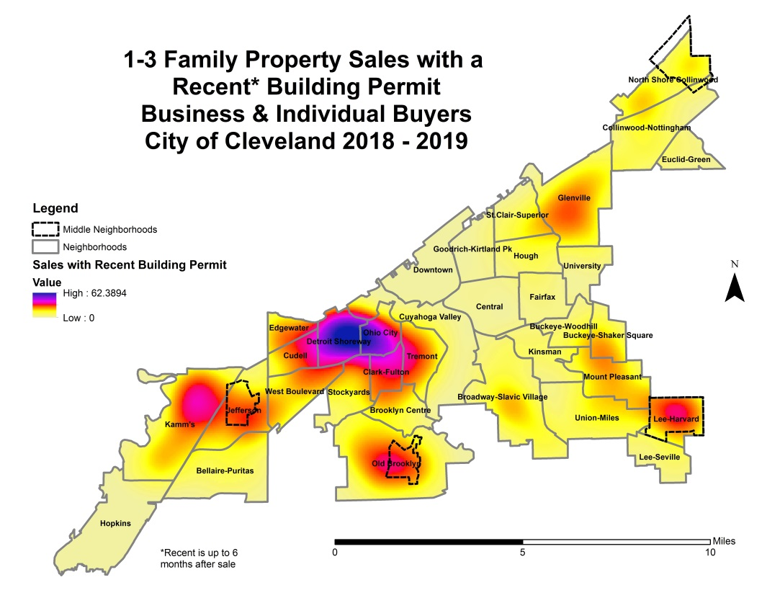
2018 & 2019 Sales with Recent Permits
When mechanical permits are excluded, building permit activity is largely focused on the near west side, with smaller clusters in Kamm’s, Old Brooklyn, Lee Harvard, and a bit of activity in Glenville
Construction permit activity is occurring more broadly across City

Slide 35
Conclusions from Quantitative Data
Percentage of buyers of 1-3 family homes that are businesses increased substantially from 2004 to 2020
  Submarkets most impacted are east side of Cleveland and east inner ring suburbs
Businesses tend to buy at the lower end of the market and individuals at the higher end
  The exception here is the east side of Cleveland, based on price and quality data
East side of Cleveland housing prices have not recovered from foreclosure crisis and businesses and individuals are buying at similar price points and of similar quality
Distressed sales are occurring most often on the east side of Cleveland to businesses and individuals at generally the same rate
Does this indicate that many individual buyers on the east side of Cleveland are investors themselves? Are potential owner occupants able to get mortgages for low value purchases?
Construction permits are being issued throughout the City, but only on about 10% of sales
  Building permits are more focused on the near west side with a few other clusters of activity
Businesses have registered their new purchases as rentals more often from 2017 to 2019, but the overall rate is only about 20% over the last 3 years

Slide 36
Conclusions from Quantitative Data
Data points to three less than ideal possible scenarios
  This is taking together price, quality, permit, and rental registration data
Businesses are speculating or otherwise holding property vacant without improving it through legal rehab
Businesses are renting property out without registering it, obscuring it from rental inspection process and near future lead registry
Businesses are renovating property without pulling permits, throwing into question quality of work

Slide 37
Qualitative data
In depth research by VAPAC investor working group on different types of investors

Slide 38
Investor Archetypes
New investor tactics are always emerging based on housing market outcomes and policy responses. Below are three types of investors currently seen on a consistent basis in Cuyahoga County.
Bulk Property Manager
  Owns few to no properties themselves
  Brings in outside investors, often out of state
  May have a contract with owner that in essence tilts towards evicting often
  May dominate housing market in a neighborhood
  They said, they said when it comes to repairs
Agent Web
  Agent likely started as investor themselves
    Now they may just do YouTube videos and real estate guru newsletters to attract clients
  Can be something lost in translation for new investors agent brings to the market; When those investors have a failure, they need to attract new investors themselves
  Worst properties end up cycling through to least prepared investors
  Often ends up as something that looks like a pyramid scheme crossed with a game of telephone
Mom and Pop
  Smaller inventory
  Tend to be more willing to work with tenants and local officials
  More vulnerable to market cycles, cash or access to credit for repairs may be lacking

Slide 39
Policy Recommendations
Built by reviewing both quantitative and qualitative data
Many are being developed from this data but a few are presented here
Hold accountable every person or entity with a responsibility to maintain property
Transfer existing property maintenance violations to new owners
Require local agent-in-charge for non-local owners
Make better use of the ability to use both criminal and civil proceedings for code compliance
Enhance enforcement of rental registration ordinances
Require interior/exterior inspection including assessing lead hazards every 3 years
Make repair capital accessible to mom-and-pop landlords through loan loss reserve fund
Require enhanced buyer information for online Sheriff Sales and the naming of a local agent-in-charge
Create targeted down payment assistance program to spur homeownership in areas with high business activity
Explore the creation of a county level housing court, similar to Franklin County’s Environmental Court
Establish a county housing trust fund with a dedicated funding source
Commit to funding for remaining demolition need

Slide 40
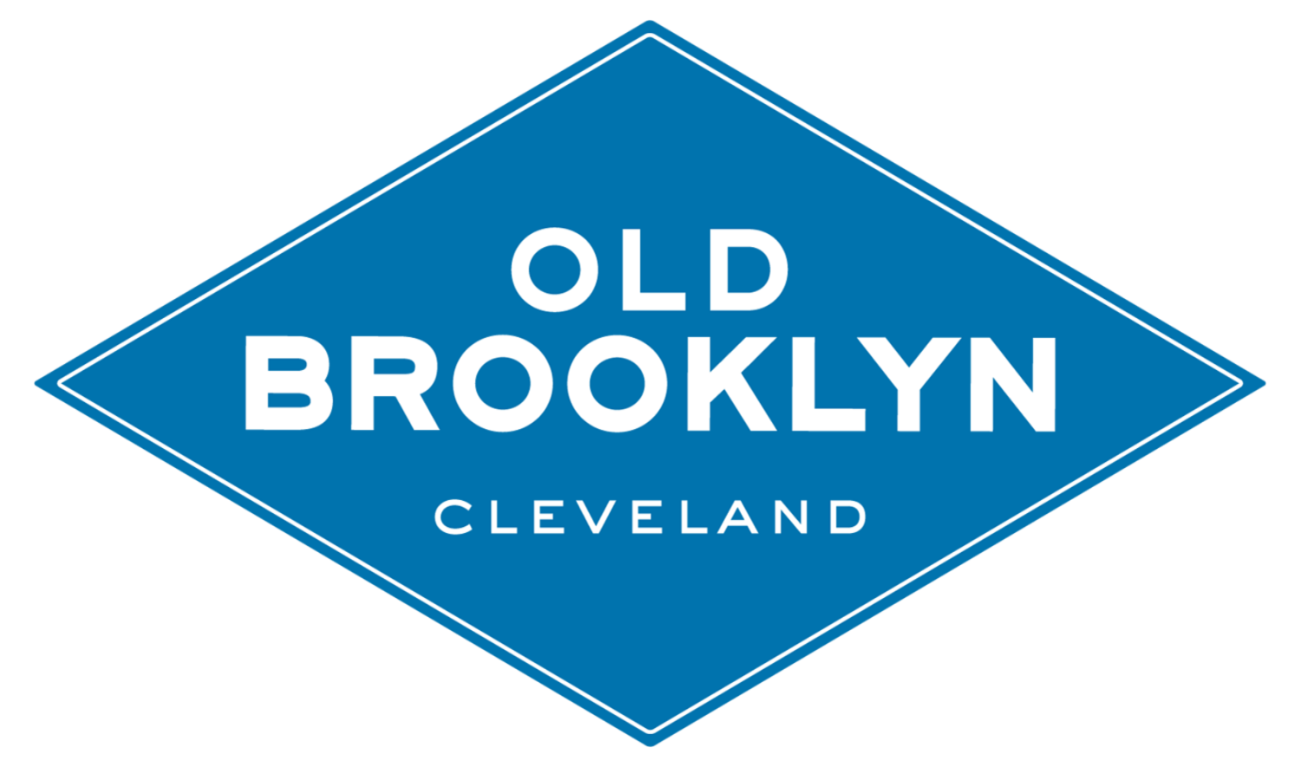
The Impact of Bulk Buyers on
Neighborhoods & Families
Institutional and Foreign Investors in Middle Neighborhoods
November 16, 2021
Notes:
Hi Thank you for joining this brown bag lunch!
My name is Jayme Lucas-Bauer, and I’m with Old Brooklyn CDC. We’ve been tracking bulk buying activity for several years and I’m happy to share what we’re learning.

Slide 41
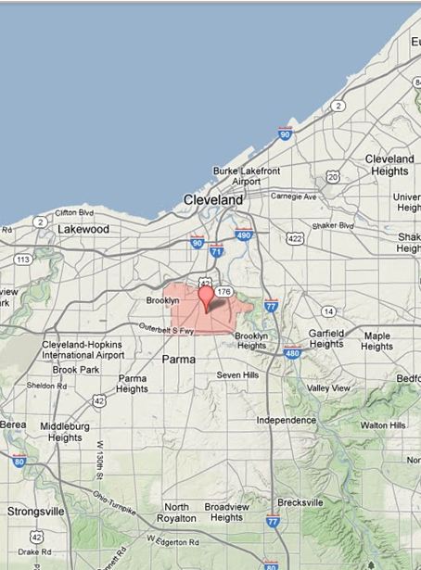
Old Brooklyn Basics
Old Brooklyn is the largest neighborhood in Cleveland at approx. 6 sq. mi. and home to 35,000 residents.
Fastest growing Latinx and African American populations in Cleveland.
Middle neighborhood:
  Never bottomed out so not many demos (also not many big redevelopment opportunities).
  Currently stable, but at risk of becoming destablilized.
Notes:
Since Old Brooklyn is probably not the center of all of your universes…
Old Brooklyn is Cleveland’s largest neighborhood, at 6sq miles and about 35,000 people. About the same as Shaker Heights.
We are the quintessential middle neighborhood. Still stable, but teetering and could go either way. And we never fully bottomed out so we don’t have the larger development opportunities that brought neighborhoods like Ohio City and Tremont back to life.

Slide 42
Real Estate Management &
Brokerage Firms
Most aggressive players in Greater Cleveland’s Middle Neighborhoods are Property Management & Brokerage Firms.
Will not permit entry to a listed house unless they receive and accept an offer.
How they make their money?
  Buyer pays them to rehab property (they offer various levels of work)
  Buyer pays them to manage property
Effects of these practices
  Many clients of theirs wind up being out of state investors
  They appeal to new or incompetent investors by pandering to their lack of knowledge and experience
  Its hard to track down their physical impact as they do not hold the properties
Notes:
There are many types of investors, but the most aggressive ones in our neighborhood (and many other middle neighborhood communities) are the real estate management and brokerage firms.
They work to attract inexperienced, out of town investors so they can get all the fees! Contracting, property management, evictions, land scaping, snow removal, and even pest removal. All the fees.

Slide 43
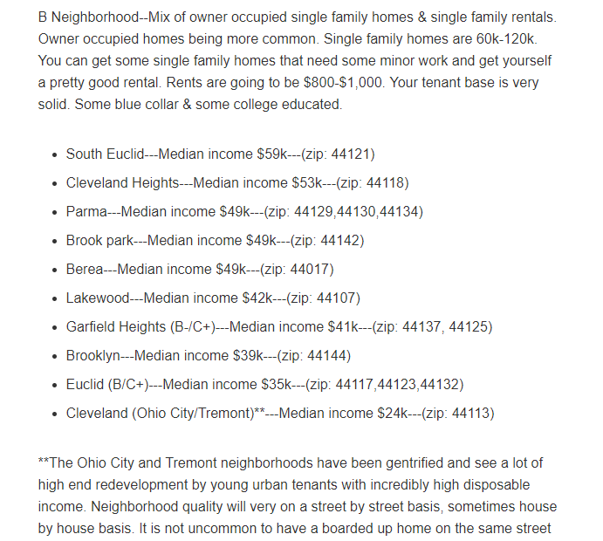
What types of homes are targeted by
investors and management/brokers?
Mid range prices between $60K-$120K.
Stable, middle neighborhoods like Old Brooklyn and many first ring suburbs, where they can charge rents $800-$1000 mo.
Source: https://www.biggerpockets.com/member-blogs/4704/42419-cleveland-neighborhood-grades
Notes:
Property Management and Brokerage firms (and their investors) target middle neighborhoods. They want communities stable enough to attract families that will pay $800-1100 month in rent, still have a mix of owner occupied homes and rentals, incomes of at least $40K and homes in mid range prices.

Slide 44
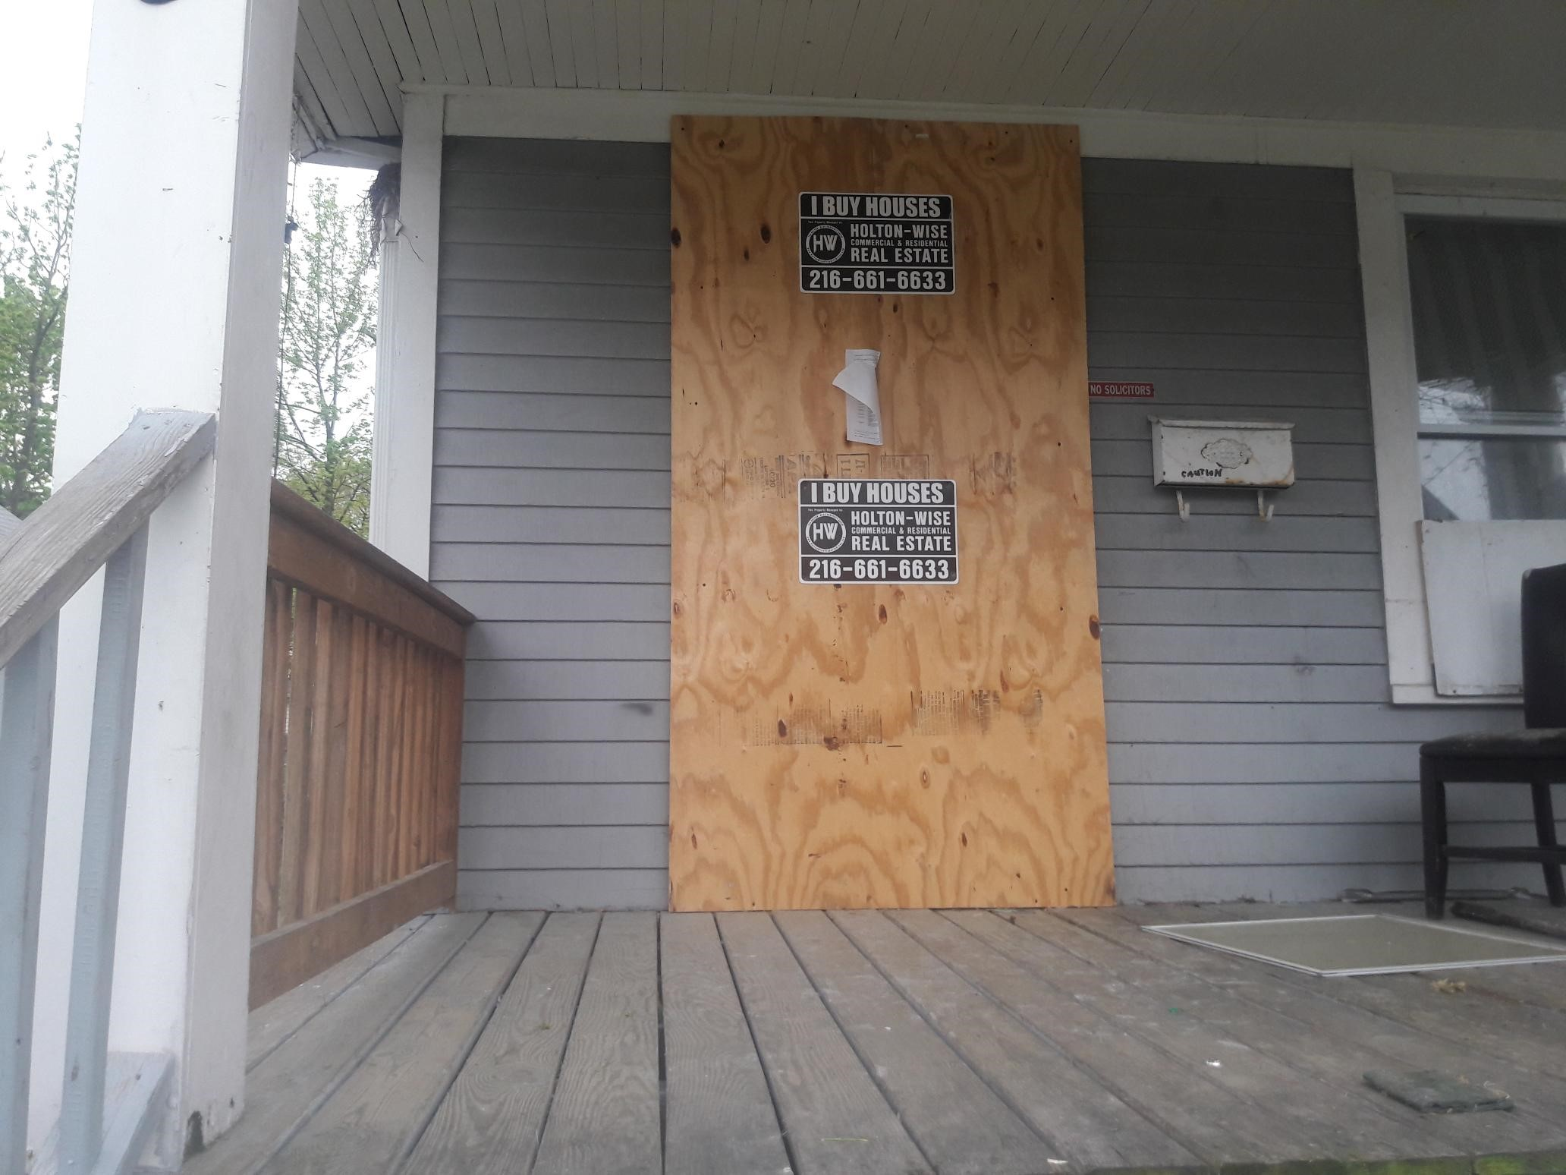
The Impact of Bulk Buying
on Streets & Neighborhoods
Bulk buying destabilizes housing values for the homes being purchased and nearby homes.
Bulk buyers rarely make real investments in properties. Homes become cash cows until completely deteriorated.
Bulk buying removes affordable homes from the market, forcing low and moderate income families to become renters.
Notes:
Bulk buying destabilizes our communities. They bring housing prices down, housing becomes more deteriorated over time, and low and moderate income families lose their ability to build wealth through home ownership.

Slide 45
Troubling Trends
We are seeing larger players entering our single-family market
  3 buyers with $2 Million or more bulk transactions purchased 27 homes in 2021.
  4 foreign entities, who appear to be related to each other and Holton Wise, purchased 16 homes in Old Brooklyn and 130 in Cuyahoga County in 2021.
The percentage of bulk buyers, LLCs, etc. purchasing single-family homes continues to increase:
    2021: 26.2%
    2019-2020: 23.9%
    2017-2018: 18.2%
    2015-2017: 16.9%

Slide 46
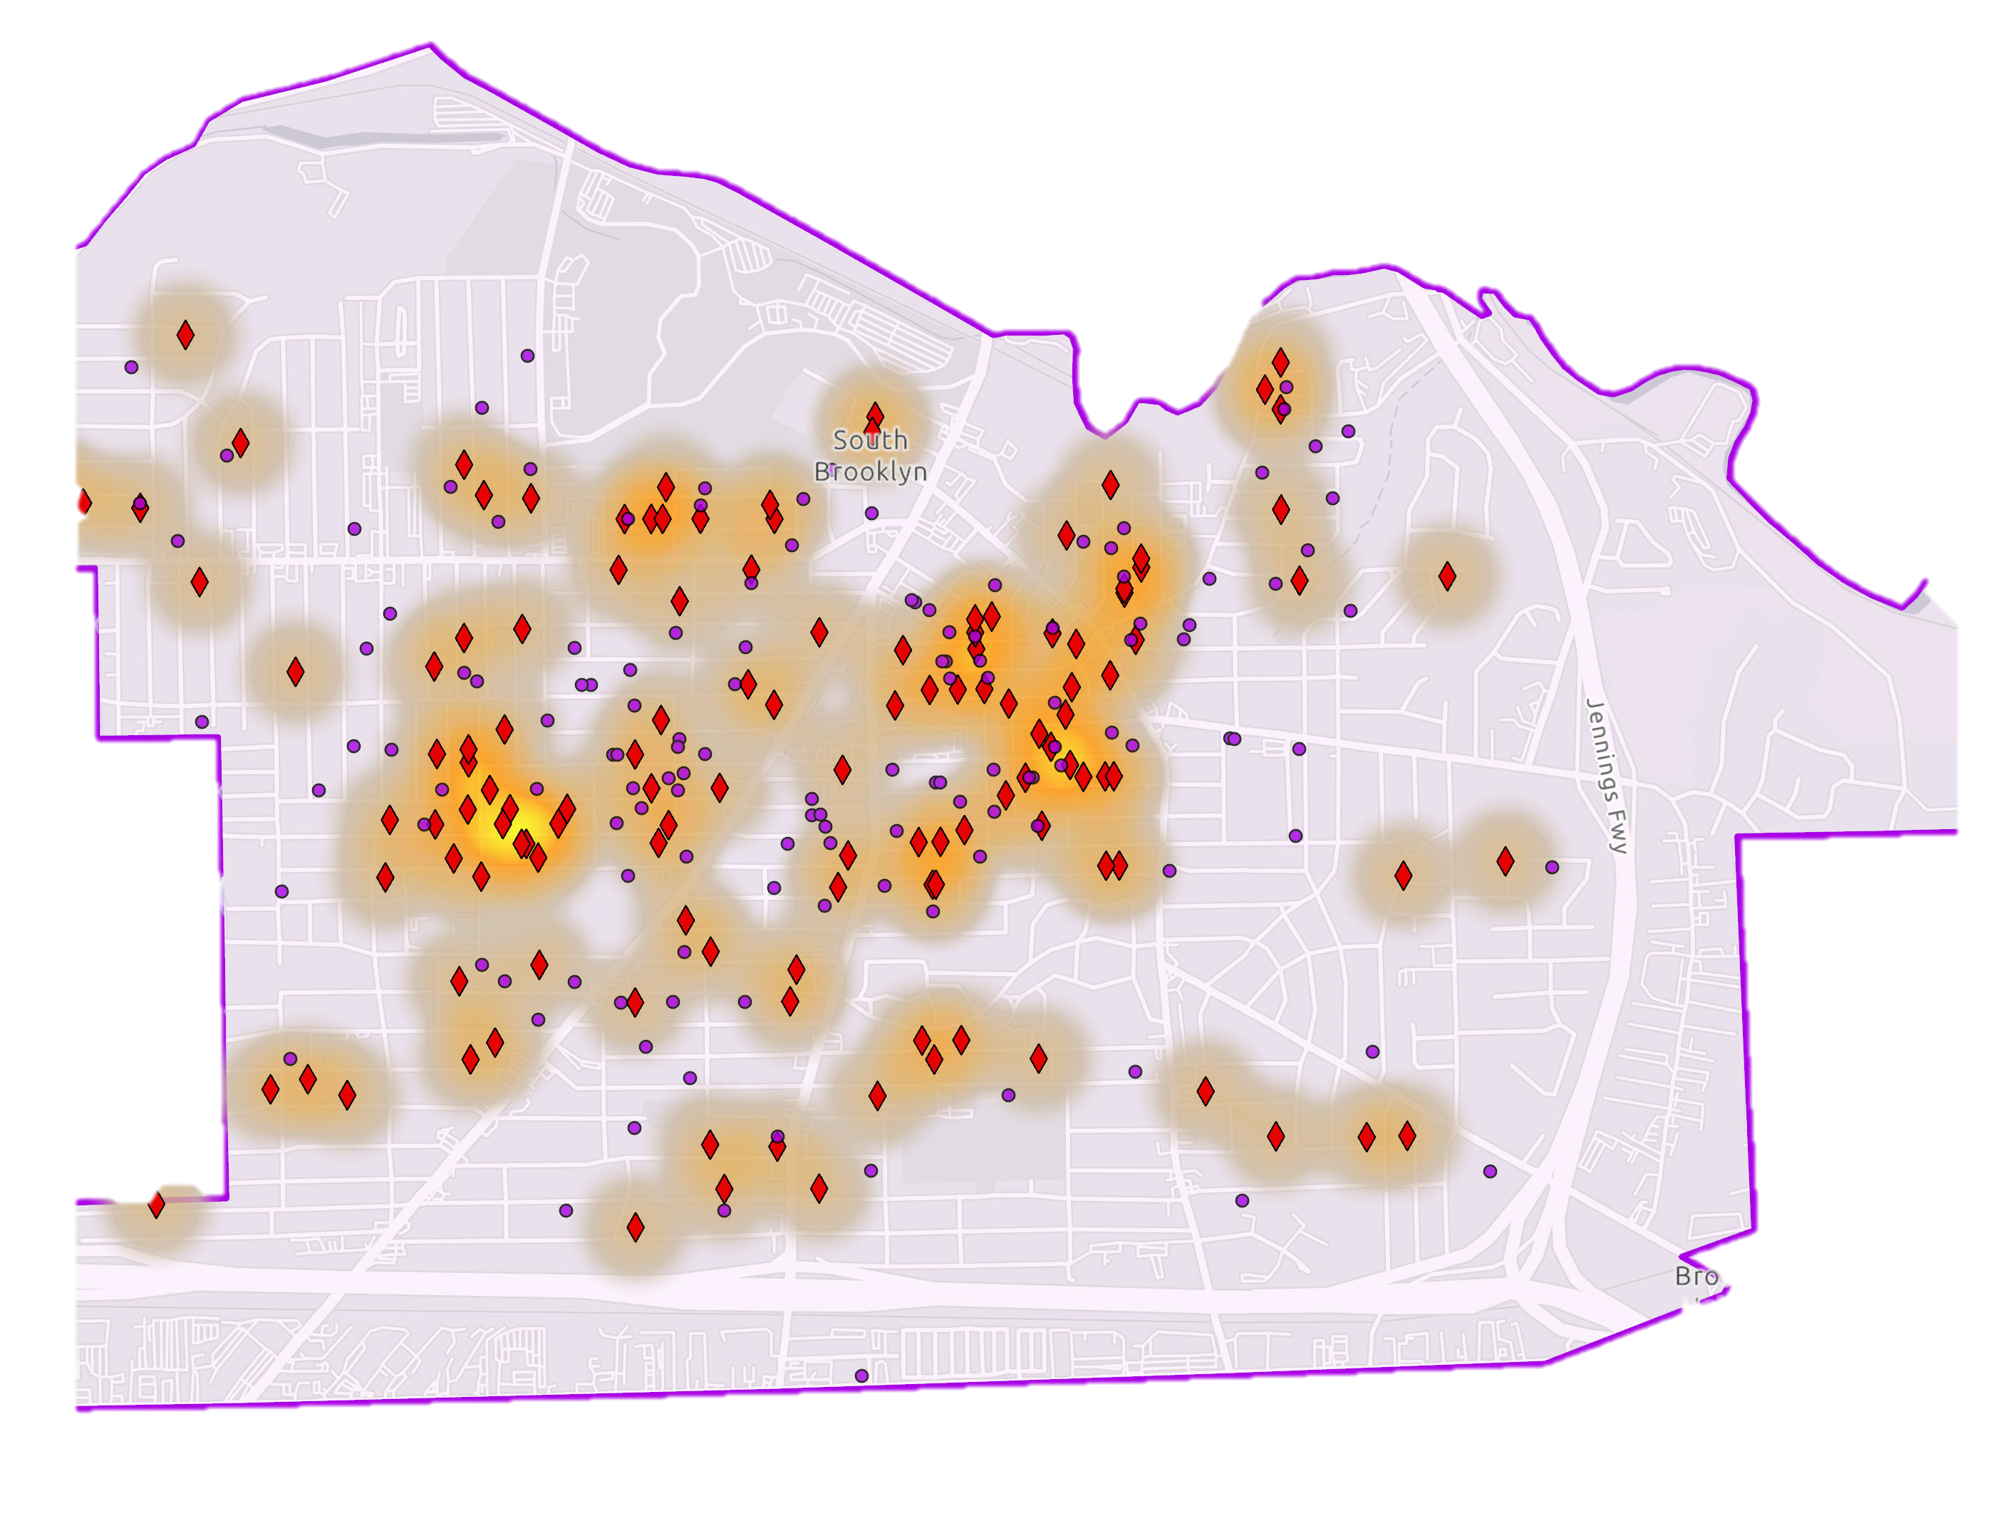
The Concentration of Bulk Buying in Old Brooklyn
Notes:
Brighton Corridor and concentration along other commercial corridors. Weakens housing and commercial markets.

Slide 47
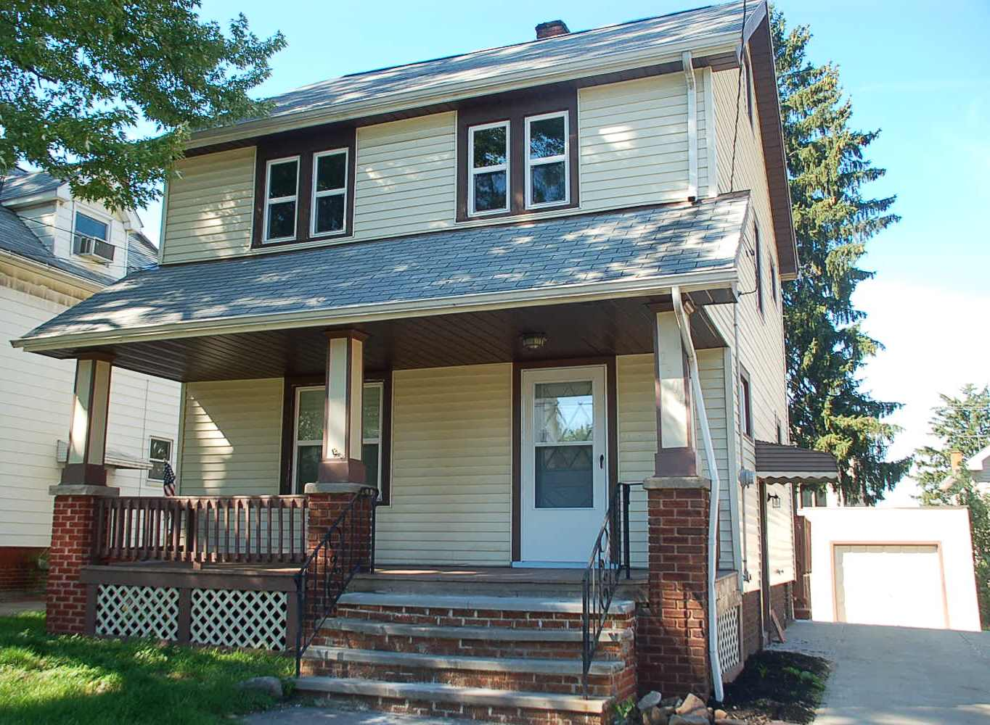
A Deeper Dive
Overall 2021 Median Sales Price for Single Family Homes: $114,000
Median Sales Price for Bulk buys: $89,000
Median Sales on streets with the highest concentrations of bulk buying: $80,750
Bulk buyers are targeting long time homeowners, grantees of probate cases, etc.
Bulk buyers are nudging owner occupant buyers out of the market with cash, no contingency offers.

Slide 48
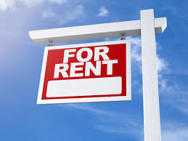
The Impact of Bulk Buying
on Low-Moderate Income Families
Bulk buyers buy up housing that is affordable to low and moderate income families, forcing them to be renters rather than build wealth through home ownership.
  Low income families can afford homes in the $50,000-80,000 range. (50% AMI)
  Moderate income families can afford homes in the $80,000-$100,000 range. (80% AMI)
Once in the hands of bulk buyers, natural affordable homes will permanently be rentals.
Notes:
As mentioned earlier, bulk buying doesn’t just impact communities, it directly impacts the ability of low and moderate income families to grow wealth through home ownership.

Slide 49
Thank you!
Jayme Lucas-Bauer
Neighborhood Development Project Manager
jaymel@oldbrooklyn.com
216-459-1000
Notes:
Thank you for your time! I hope this was informative, and I’m happy to answer any questions.

Slide 50
Recommendations
Strong code enforcement is critical!
Coordination with law department is essential!
Regional information sharing is powerful!

Slide 51
Key Recommendations of the VAPAC Investor Working Group
Hold every person or entity with a responsibility to maintain property accountable
Require local agent-in-charge for non-local property owners
Transfer existing property maintenance violations to new owners
Make better use of the ability to use both criminal and civil proceedings for code compliance
Expand right to counsel, enact pay to stay and source of income protection legislation
Enhance enforcement of rental registration ordinances
Require an interior and exterior inspection including assessing lead hazards every three years
Make repair capital accessible to mom-and-pop landlords through a loan-loss reserve fund and provide significant grant funding for lead remediation
Ensure that adequate funding is available to demolish vacant parcels that cannot reasonably be rehabilitated
Create a targeted down payment assistance program to spur homeownership in areas with high rates of business ownership

Slide 52
Q & A
Sally Martin
  Housing Director
  City of South Euclid
Timothy Kobie, PhD
  Business Process Analysist
  City of Cleveland
Jayme Lucas-Bauer
  Neighborhood Development Project Manager
  Old Brooklyn CDC

Slide 53
Subscribe
Center for Community Progress
Check out: The Cornerstone Webinar Series

Slide 54
Next Webinar
December 16, 2021
Sunbeld Middles
Lori Shwarz
Alan Malach
TIME

Slide 55
Thank you for joining us!
Please email us if you have ideas for webinars, case studies, news stories, etc.
Tell us about your experience today!

Slide 56
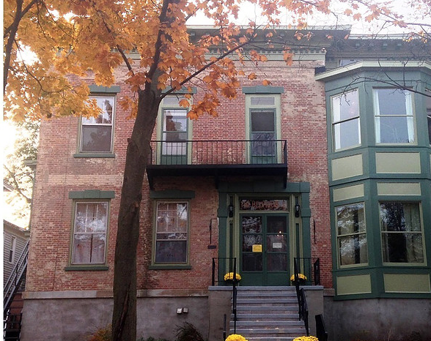
JOIN US!
The Middle Neighborhoods Community of Practice
(CoP)
The Middle Neighborhoods CoP is an informal, facilitated network of practitioners, researchers and policymakers engaged in revitalizing middle neighborhoods. CoP members share learnings through topical webinars, referrals, site visits, phone calls, and occasional larger group events.
There are currently more than 800 people in the CoP. Please join us!
middleneighborhoods.org

Slide 57

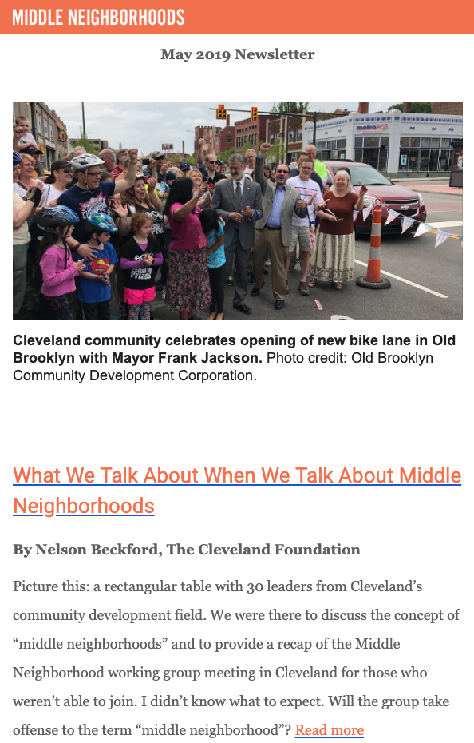
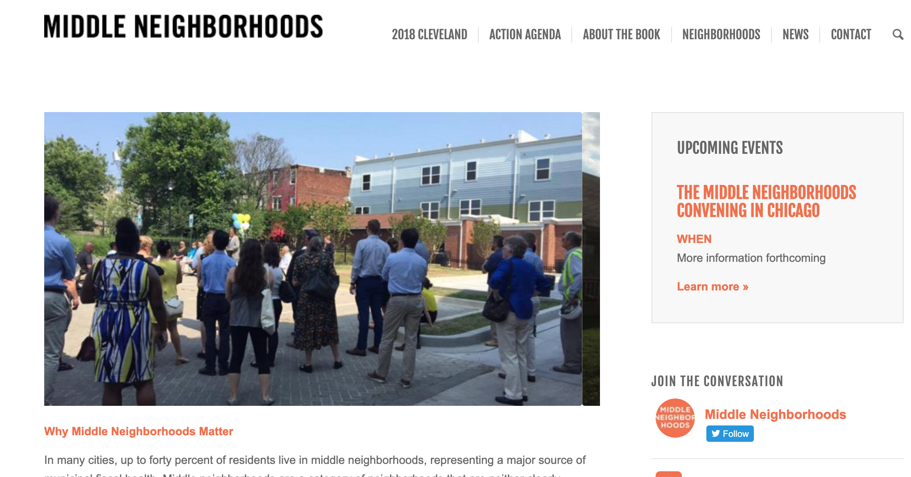
For more Information
Questions or Ideas?
www.middleneighborhoods.org
Mapping Tool: http://middleneighborhoods.reomatch.com/

