Slide 1
NCST Community Impact Briefing
Pittsburgh Community Reinvestment Group July 17, 2024

Slide 2
OUR MISSION
PCRG builds the capacity of community development leaders to achieve racial and economic equity in Southwestern Pennsylvania.

Slide 3
Agenda
About PCRG
Black population trends
Black homeownership and home purchasing trends
Explaining factors that affect Black homeownership
Community Reinvestment Act (CRA) Basics
Policy Actions/Programs

Slide 4
PCRG Background and History
PCRG is a nonprofit membership and research organization of community development corporations (CDCs), community-based organizations (CBOs) and community service groups in Western Pennsylvania. We ensure that our region has one voice in organizing for equity in financial lending practices, land use and vacant property, transit and infrastructure.
PCRG was organized in 1988 as a coalition of community-based organizations to provide a coordinated response to the bank practice of “redlining” – the refusal of conventional mortgage credit in low-income communities.
PCRG’s work has adapted to the changing landscape of community development and has grown to meet the needs of its members and communities. Today, PCRG is also actively involved in solving issues surrounding vacant property, transit, and environmental justice.

Slide 5
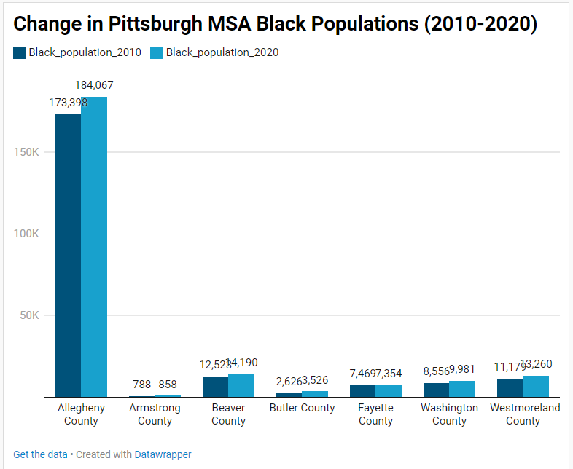
Black population changes in MSA Counties
In 2020, Allegheny County has the highest Black population at 184,067, followed by Beaver County with 14,190 Black residents and Westmoreland County with 13,260 Black residents.
The highest change in percentage of the Black population was experienced by Beaver County, where the Black population constituted 7.34% of the county’s population in 2010 and 8.44% of the county's population in 2020.

Slide 6
Black population changes in Allegheny County
Some municipalities that experienced high losses in Black population between 2010 and 2020 are Sewickley, Wilkinsburg, City of Pittsburgh, Rankin, Braddock, Homestead and Swissvale. City of Pittsburgh lost 8,156 Black individuals between 2010 to 2020.
Some municipalities with a 500+ increase in Black population in the last decade are Penn Hills, Monroeville, McKeesport, McKees Rocks, Stowe Township, Wilkins Township and Pitcairn. All the municipalities listed that experienced an increase in Black population also experienced a simultaneous decrease in White population.

Slide 7
Black population changes in the City of Pittsburgh
Some neighborhoods with a more than a 500+ decrease in the Black population are East Liberty, Highland Park, Terrace Village-West Oakland, Upper Lawrenceville, Point Breeze North, Garfield, Homewood North, Marshal-Shadeland (Brightwood) and Lincoln-Lemington-Belmar.
On the other hand, neighborhoods that saw the largest increase in Black population are Carrick, Northview Heights, Brookline, Esplen-Sheraden, South Side Flats, Crafton Heights and Brighton Heights.

Slide 8
Black Homeownership
Black Homeownership rate is the percentage of Black households that are homeowners.
In Pittsburgh city, the median Black homeownership rate in all city census tracts was 25.2% in 2010 and it is 26.76% in 2020.

Slide 9
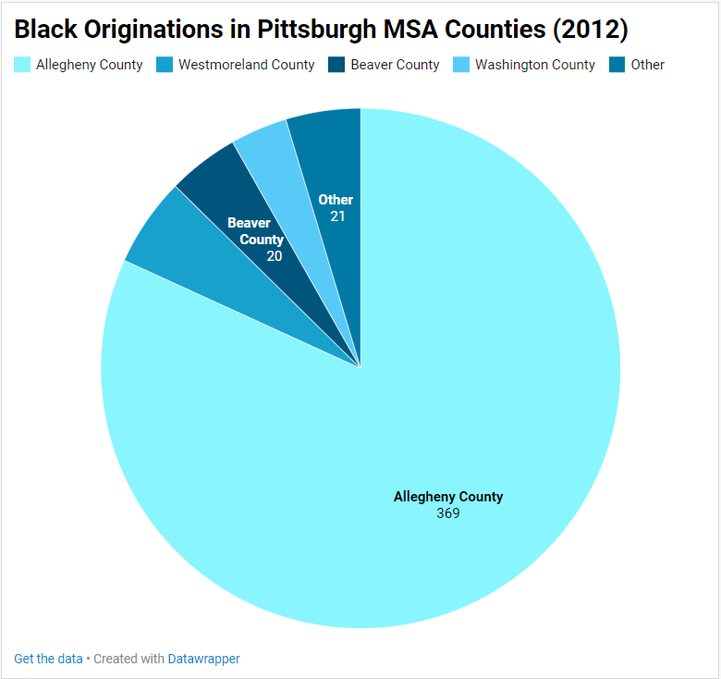
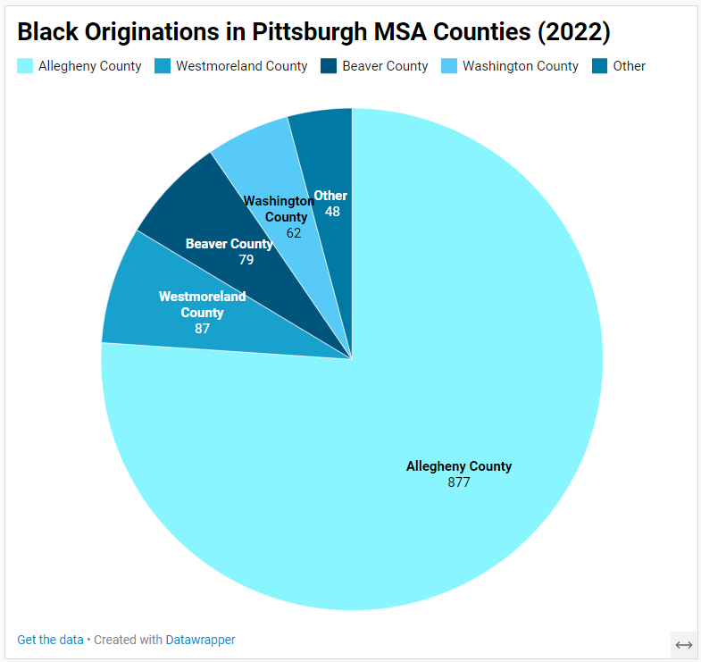
Relative increase in Black home purchasing outside Allegheny County
In 2012, 81.81% of Pittsburgh MSA Black mortgage loans originated in Allegheny County. However, in 2022, Allegheny County originated 76.06% of the MSA’s Black loans. On the other hand, the share of Black loans originated in Beaver, Butler, Washington and Westmoreland counties increased.

Slide 10
The slide before shows single family home purchase originations by Black borrowers in Pittsburgh MSA counties in 2012 and in 2022.
The share of Allegheny County Originations or the size of its pie is decreasing while originations in other counties are increases.
This depicts relatively higher demand in home purchasing outside Allegheny County from 2012 to 2022 for Black home buyers

Slide 11
Similarly, within Allegheny County, Turtle Creek, Wilkinsburg and Monroeville are municipalities experiencing the highest relative increase in Black single family home purchase loans from 2012 to 2021.
On the contrary, City of Pittsburgh, Penn Hills and Moon Township are experiencing the highest relative decline in Black home purchase loans from 2012 to 2021.

Slide 12
Explaining the Gap in Homeownership of Races
The chart shows changes in denial rates of HMDA reported home purchase loans in Pittsburgh MSA for white borrowers and Black borrowers. This is a clear sign of barriers to credit access and thus homeownership.

Slide 13
Corporate Homeownership is another factor affecting Black Homeownership Rates
From 2010 to 2021, the share of houses sold to corporate entities or real estate investors in the City of Pittsburgh increased from 15.5% of sales in 2010 to 24.8% of sales in 2021 while paying a fraction of the price of regular homebuyers. The remaining communities of Allegheny County experienced a similar increase from 9.7% of sales in 2010 to 18.0% of sales in 2021.
In Pittsburgh and the remaining parts of Allegheny County, many of these census tracts with a higher share of corporate sales reflect historically Black and or Low- and Moderate-Income (LMI) communities.
On average, corporate entities paid 70.2% of the average sale price, compared to all purchases in Pittsburgh and 72.4% of the average sale price in the remaining parts of Allegheny County.

Slide 14
Policy/Program Actions
Special Purpose Credit Programs
Local Land Use policies---Land Recycling (land banks)
Federal Regulations-new CRA, State level CRA
Federal Legislation—Neighborhood Homes Investment Act—Working with Homeownership Alliance!
Expand affordable homeownership production

Slide 15
Special Purpose Credit Programs (SPCP)
SPCP are loans that are targeting historically disadvantaged communities.
Federal regulators recently issues clear guidance for banks to offer SPCP. Falls within the provision of the Equal Credit Opportunity (ECO) act.
Some institutions have been now offering SPCPs to consumers; PCRG educating more institutions on SPCP to expand the offering.
Examples: Downpayment assistance for first-time homebuyers, low credit score, closing cost assistance

Slide 16
Local Land Use Policies
PCRG works with government stakeholders to advocate for affordable homeownership opportunities - Pittsburgh Land Bank - end user scorecards - Homeownership Programs - Urban Redevelopment Authority/ Banking Partners; example: OwnPGH
PCRG facilitates working groups - Vacant Property Working Group (VPWG) - Black Developers Cohort- technical assistance - Bankers Councils- Mid Tier Bankers Community Council & Community Bankers Community Council

Slide 17
Federal Regulations: Community Reinvestment Act (CRA)
The Community Reinvestment Act (CRA), enacted in 1977, to assess whether banks are meeting the credit needs of all service area equally. Regulators issued the last update in 1995, and the new CRA rules and regulations issued on October 24, 2023
Under the existing rules, banks get CRA credit for $300-$400 billion a year in loans made to low-to-moderate income households or in low-to-moderate income communities across the country. That’s a higher annual spending than HUD or the Department of Transportation or the Department of Education.
Those billions of CRA-qualifying loan dollars include loans for single-family and multi-family residences, small businesses, small farms and community development.
After several years and now two White House administrations, the newly updated (but still race-neutral) rules and regulations will still end up influencing how and where those dollars flow. It’s the first comprehensive overhaul to CRA rules since 1995, long before the rise of online and mobile banking.

Slide 18
State Level CRA
Illinois lawmakers passed their state CRA law in 2021 and then spent more than two years designing its implementing regulations, which were formally adopted this May. - Covers non-depository institutions, credit-unions and race-based contributions by lenders
No such law in Pennsylvania
Other states with a state CRA law: West Virginia, New York state, Massachusetts, Connecticut, Rhode Island, Washington, and Washington D.C.

Slide 19
Federal Legislations/Programs
Neighborhood Homes Investment Act - PCRG is working with national partners like Homeownership Alliance. Federal tax credit for homeownership
FHA lowering annual mortgage insurance premiums.
HUD's first generation downpayment assistance program at or below 120% of AMI - Analysis estimates 35% of program participants would be African-Americans according to Urban Institute
HUD HOME Investment partnerships program (HOME program) - Constructive rehab affordable rental housing and provide homeownership opportunities

Slide 20
Thank you
ehogan@pcrg.org
crosselot@pcrg.org

