Slide 1
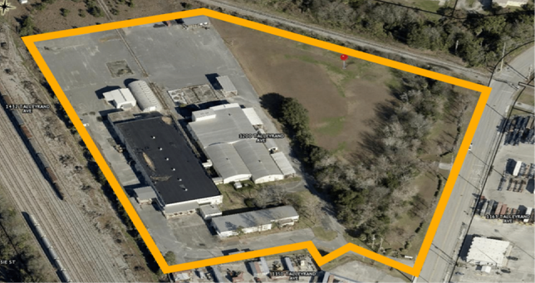
“Housing Solutions Center of Jacksonville” Modular Housing Factory & Research Center Jacksonville, Florida – Historic Eastside

Slide 2
Our History…
Founded as Adopt A Hurricane Family in 2005… Helping over 400 Hurricane Katrina & Wilma displaced families.
Entered housing development in 2007 with Hurricane Wilma Mobile Home Replacement Program – Managed entire HUD DRI-funded program for Town of Davie - 83 new units.
Became a HUD approved Housing Counseling Agency in 2009 – dba Crisis Housing Solutions
During the Great Recession, CHS created our Community Stabilization Initiative – Acquired, rehabbed and sold 105 foreclosed homes to Low-to-Moderate Income families.
J.P. Morgan Chase funds Feasibility Study comparing repurposed shipping containers to concrete block housing. Study sends us to The Netherlands, England and throughout U.S. Favorable results lead to search for modular housing factory & research center.
Site found and secured at 1200 Talleyrand Avenue in Historic Eastside, Jacksonville, FL.

Slide 3
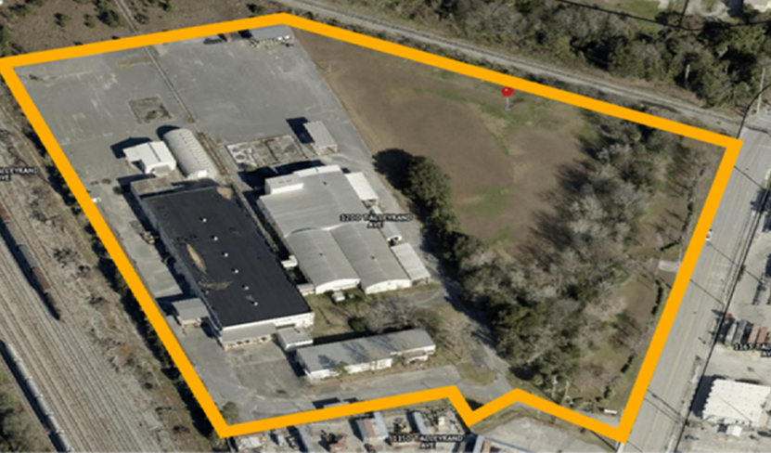
Housing Solutions Center of Jacksonville
1200 Talleyrand Avenue, Eastside / Jacksonville FL
New Manufacturing for Jacksonville
Emergency Post-Disaster Housing Units
- Program & Product reduces significant Government Waste.
Innovative & Affordable Factory-built Housing
Housing for the Homeless
Up to 150 JOBS for Eastside and surrounding Jax Communities
Employment programs and services for Veterans, the Homeless and Reentry populations.
Research Center: Partnering with state universities and local colleges to foster innovation and advancements in green technology. UF College of Design, Construction and Planning is our 1st Partner.

Slide 4
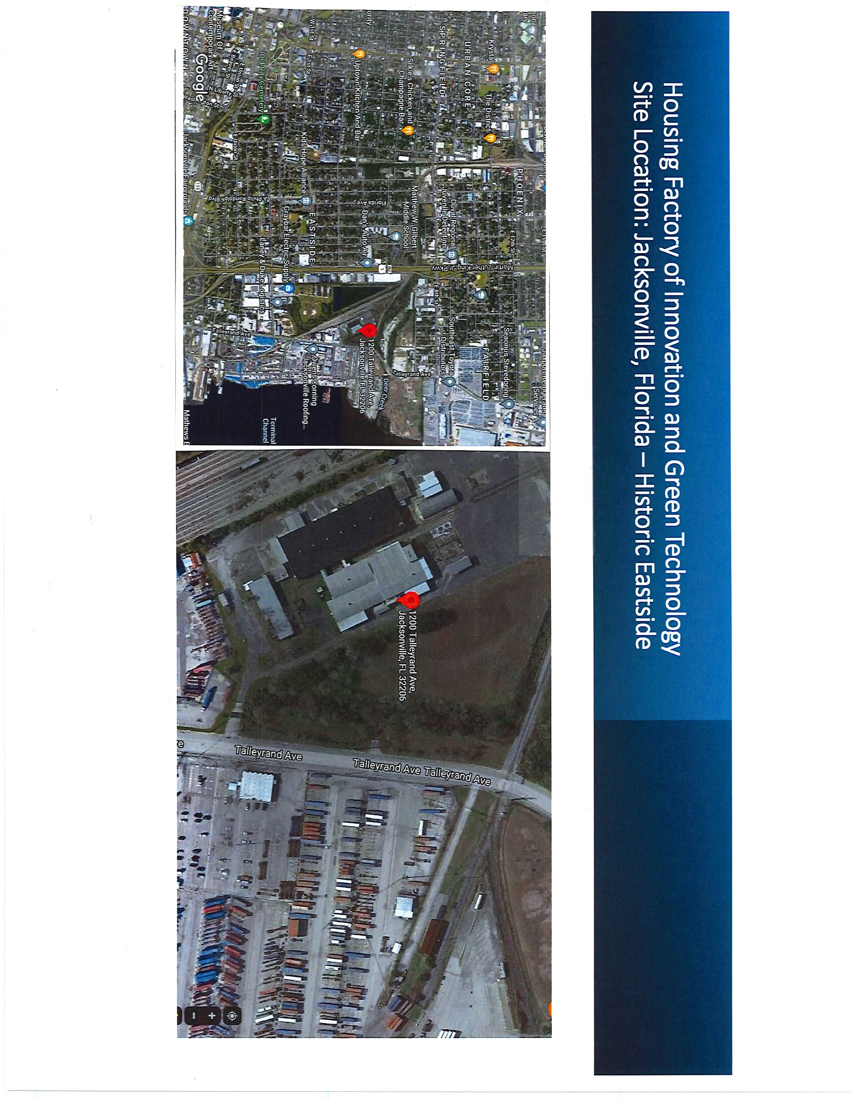
“Housing Solutions Center of Jacksonville”
A Good Start…
14-acre site secured at 1200 Talleyrand Ave.
Over 90,000 sf of buildings for Modular Housing Factory & Research Center.
5-acres+ of green space offers plenty of room for expansion.
Logistically Perfect… Located at JAX Port with rail spur and minutes from I-95 & I-10. (i.e. Road, Rail and Sea)
65-Year Lease secured.

Slide 5
Mission: “We build healthy communities where people live, work and prosper” Core Values: - Collaboration - Inclusiveness - Compassion - Determination - Community - Hope

Slide 6
Problem: LACK OF AFFORDABLE HOUSING
Skyrocketing home prices are locking out far too many Americans from wealth-building homeownership.
U.S. Price Index Comparison 2019 to 2024
Consumer Goods & Services (not housing) Rose 22.8% (Consumer Price Index)
Prices for Single-family Homes Rose 57.8% (FHFA Housing Price Index)
The U.S. faces a significant shortage of affordable housing, with approximately 7.1 million rental homes needed to meet the needs of extremely low-income renters. Nationwide, only 35 affordable and available rental homes exist for every 100 extremely low-income renter households.**
The Sunshine State has only 25 affordable and available rental homes for every 100 extremely low-income renter household.**
862,485 low-income renters in Florida pay more than 40% of their income for housing.*
Every county in the U.S has a shortage of affordable housing.**
* University of Florida Shimberg Center for Housing Studies
** National Low Income Housing Coalition

Slide 7
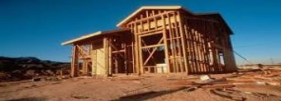
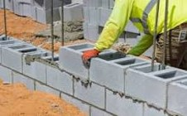
LACK OF HOUSING INNOVATION
Housing Developers and Contractors continue to build houses in the same way they did 125 years ago… generation, after generation, after generation…
Problem Continued:

Slide 8
TIME FOR A CHANGE!
With today’s technology… high quality affordable housing is being built in factories around the world, as the United States lags significantly far behind:
Country % of Modular / Prefabricated Single-family Homes built
Sweden 80+%
Finland & Norway 45%
Japan 15-20%
Germany 15%
United States 3 to 4% (majority are mobile homes…registered at Department of Motor Vehicles.)

Slide 9
Why Factory-Built / Modular Housing?
Savings in Time, Materials & Money
Never a rainy day… A controlled work environment
Quality Construction / Precision / Building Material Costs
Innovation… Ever increasing possibilities

Slide 10
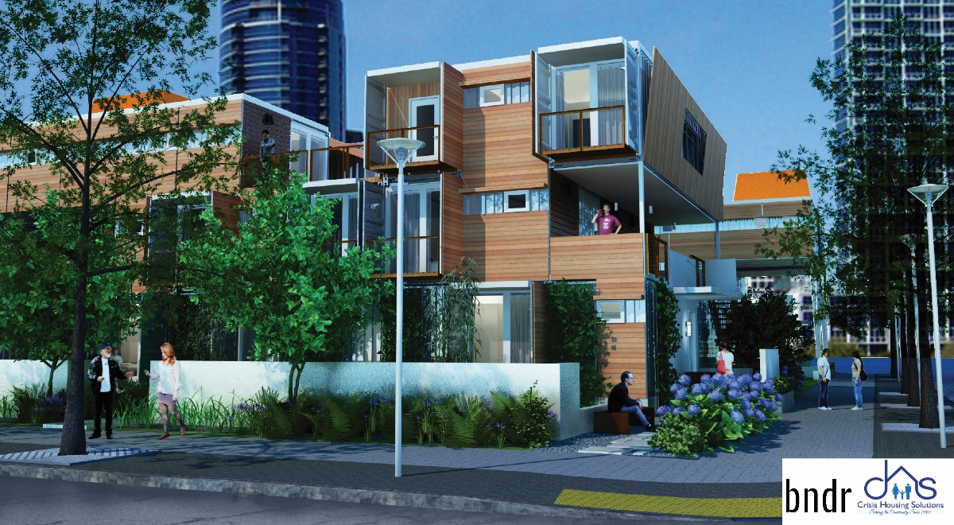
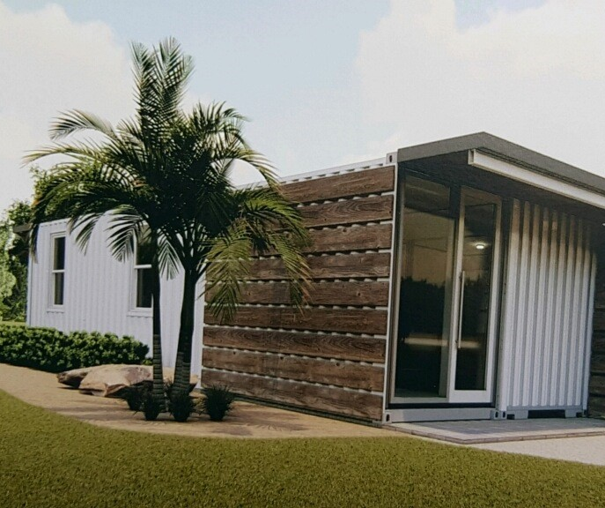
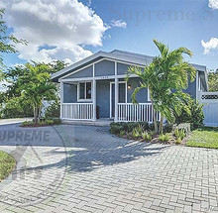
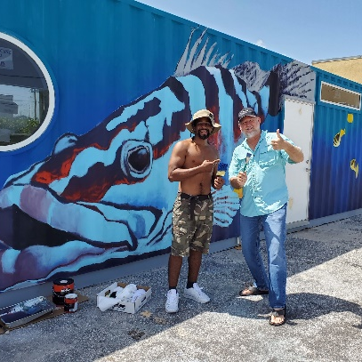
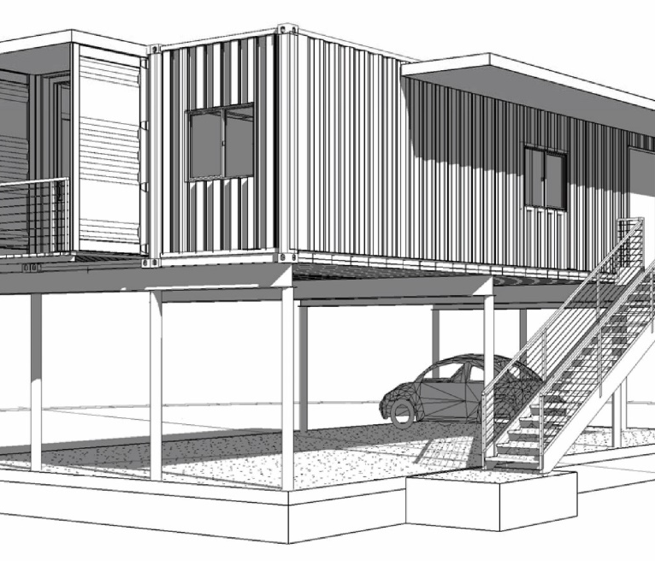
Types of Modular & Panelized Builds at the… Housing Solutions Center of Jacksonville
Structural Insulated Panels (SIPs)
Repurposed Shipping Containers
Light Gauge Steel Framing
New Innovation…

Slide 11
Build Faster – Cleaner - Greener

Slide 12
S
tructural
nsulated
anel
I
P
MGO Board laminated on both sides of extruded polystyrene

Slide 13
MGO SIPS Befits
MGO – green material
Energy Efficient – Walls R 35 Roof R 50
Won’t Grow Mold or Mildew
No Termites or Boring Insects
Fire Retardant
Water Resistant

Slide 14
Building with MGO SIPS
Faster Construction
Fewer Subs
Reduced Site Waste
Better Wind Resistance over 200 MPH
Lower Total Costs

Slide 15
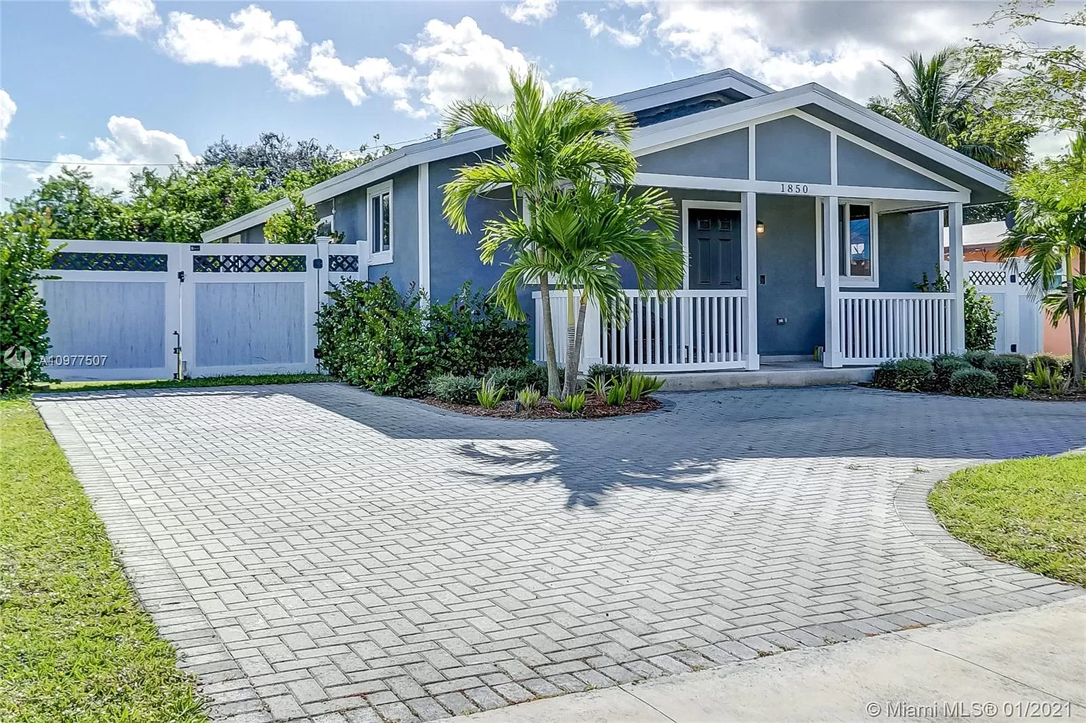
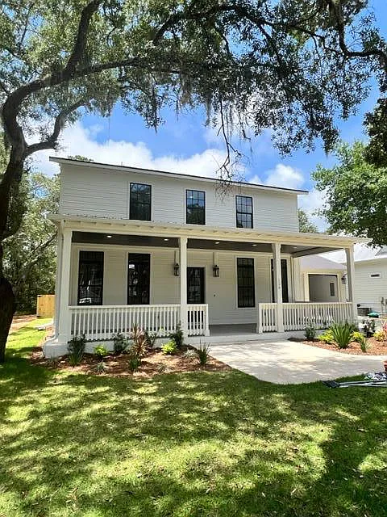
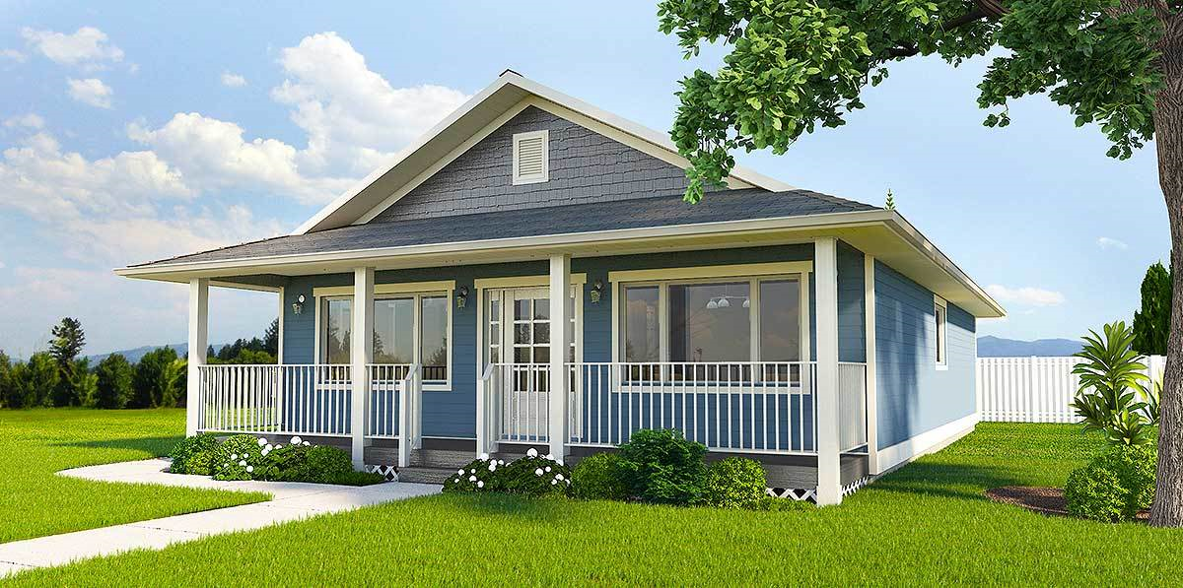
MGO SIP Homes

Slide 16
Bill Wilson - bill@supremesips.com

Slide 19
Research Center of Innovation & Green Technology
Partner with state and local universities to foster innovation in modular housing construction and advancements in Green Technology.
Develop, field test, demonstrate, and disseminate effective green home technologies for a transformational change in residential energy consumption and environmental impact.
University of Florida’s College of Design, Construction & Planning is our 1st Partner

Slide 20
Success is achieved by working together… Community Collaboration. Join us! Be a part of the Solution!! Contact: Craig Vanderlaan Mobile: 954-559-5922 email: craig@crisishousingsolutions.org

